Slide 1

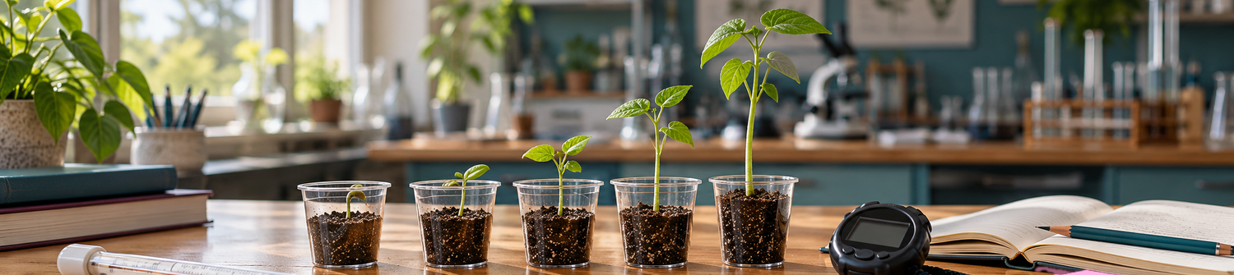
Unit 2 · Lesson 8
Explain science results
DO NOW
Match the word to its meaning.
What can a set of results tell us?
1
trend
A
where information comes from
Find the relationship in results.
2
indicate
B
say what might happen next
Content aim
Language aim
Write a results paragraph.
source
the general direction of data
3
C
The results show ___.
For example, ___.
This suggests ___, but ___.
4
conclusion
D
say something is probably true
result · relationship · variable · evidence
suggest
show or point to something
Understand how a paragraph is organised.
5
E
Skills aim
6
predict
F
a decision about what the data tells you
Write the letter next to each word.
Notes:
AT A GLANCE: Learners read results from two investigations, then write an 80–100 word results paragraph: FINDING, EVIDENCE (two figures), CAREFUL CONCLUSION. This is the shape for L9–L10.
DO NOW (4 min): match words to meanings. ANSWERS: 1 C, 2 E, 3 A, 4 F, 5 D, 6 B. Ask: "How do you know?" and for a sentence with one word.
OPTIONAL ORAL (1 min): A "The dry summer made 18,000 more people visit." B "…might be linked, but the data does not show why." B is fair; "made" overclaims.
LANGUAGE: The results show ___. For example, ___. This suggests ___, but ___.

Slide 2
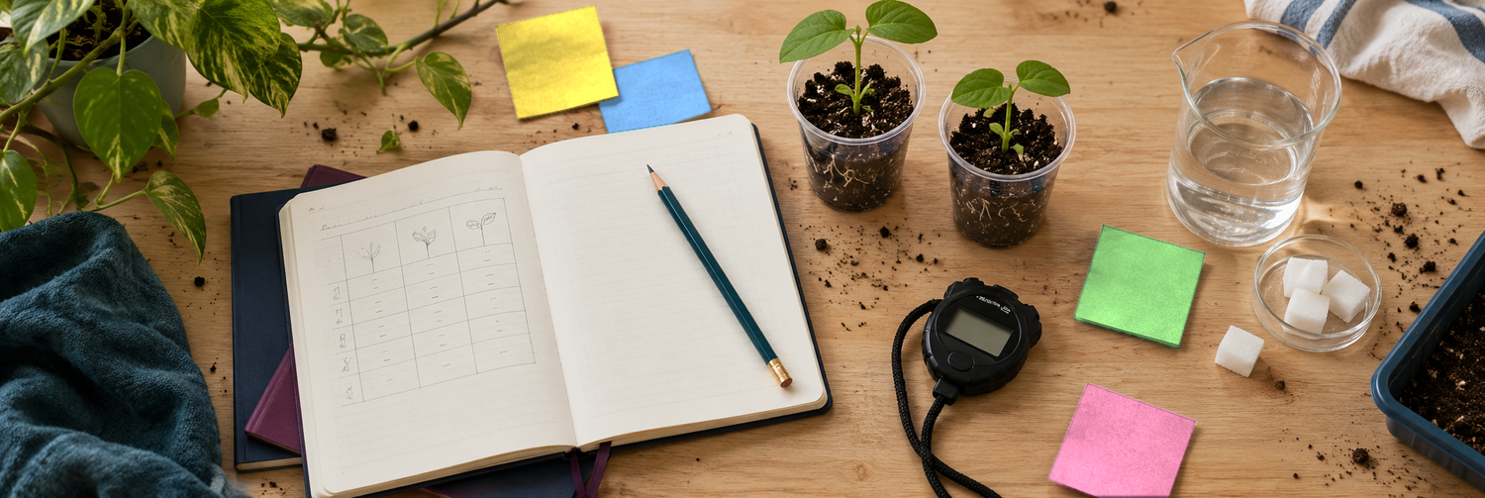
Today’s journey
1
Read the results
Quickfire questions. Key words.
Today’s aims
Study a model paragraph
Content
Find the relationship in results.
2
Find the three jobs.
Language
Write a results paragraph.
3
Build and improve
Order sentences. Improve evidence.
The results show ___.
For example, ___.
This suggests ___, but ___.
4
Write your paragraph
result · relationship · variable · evidence
Plan. Say. Write. Check.
Skills
Understand how a paragraph is organised.
Notes:
DO (1 min): Read the four steps aloud. Say: "Read the results, study a model paragraph, build and improve, then write your own."
WATCH FOR: link to the assessment: "In your Data report you will write about two displays. Today: one set of results."
LANGUAGE: finding, evidence, careful conclusion.
This slide returns after steps 1–3 (slides 7, 12, 17). Skeleton slide: do not count or cut.

Slide 3
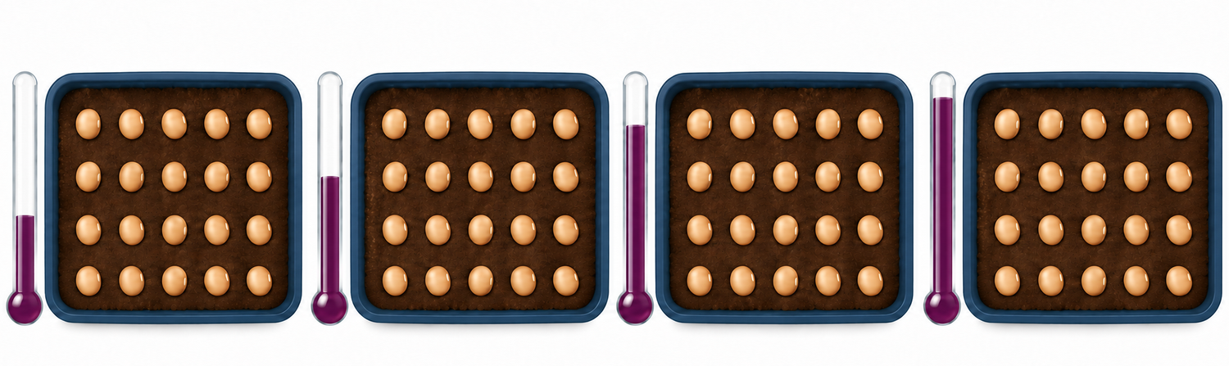
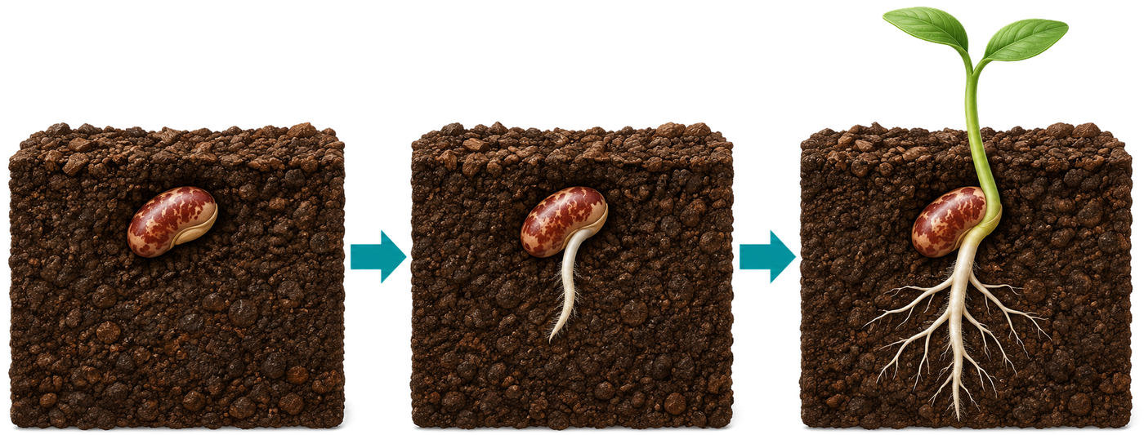
What is happening in this experiment?
A scientist tests bean seeds at four temperatures.
10 °C
15 °C
20 °C
25 °C
20 seeds
20 seeds
20 seeds
20 seeds
GERMINATE
germinate (verb)
a seed starts to grow
The seeds germinated.
seed
root
shoot
What is different? What is the same?
Notes:
DO (3 min): Pictures only: no results yet. Read the caption: "20 bean seeds in each of four trays, each at a different temperature. After one week she counted how many germinated." Ask: What is different? (temperature) What is the same? (20 seeds)
LANGUAGE: germinate = a seed starts to grow. seed → root → shoot. "The seeds germinated." Say it; learners repeat.
WATCH FOR: do not teach "variable" yet (slide 6).
PRAISE: "Good looking."

Slide 4

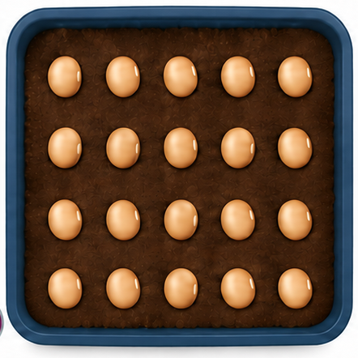
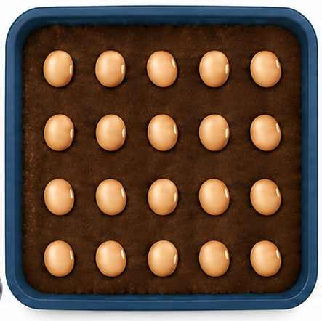
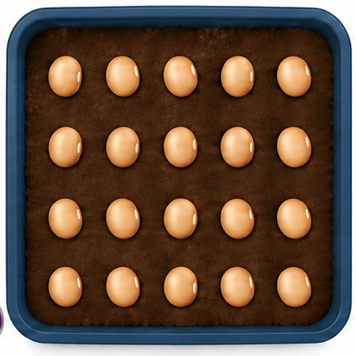
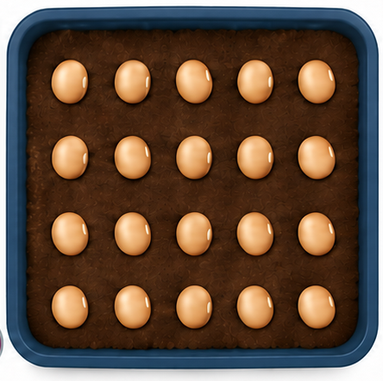
Talk and predict
Talk with your partner first.
10 °C
15 °C
20 °C
25 °C
TURN AND TALK
What is the scientist testing?
1
NUMBER OF SEEDS GERMINATED (OUT OF 20)
 | 10 °C | 15 °C | 20 °C | 25 °C
Day 1
Day 7
What changes? What stays the same?
2
How many seeds might germinate on day 7?
Predict day 7. The table is empty.
3
Say: At ___ °C, more seeds might germinate than at ___ °C.
Notes:
DO (4 min): Pairs talk with the three prompts, then write a prediction for day 7. The table is empty on purpose.
ANSWERS: 1 She is testing if temperature changes how many seeds germinate. 2 Temperature changes (10, 15, 20, 25 °C); 20 seeds, soil, water and time stay the same. 3 Any sensible numbers. Use "might".
STRETCH: Why 20 seeds in every tray? (a fair comparison)
LANGUAGE: pairs may talk in any language first, then give one English sentence.

Slide 5
Read the results
A answers odd questions. B answers even questions. Your partner checks.
SEED INVESTIGATION
STUDENT A · ODD QUESTIONS
STUDENT B · EVEN QUESTIONS
10 °C
15 °C
20 °C
25 °C
What changes?
What does the scientist measure?
1
2
20 bean seeds at each temperature. After one week, she counted how many germinated.
How many seeds were in each test?
What do °C and % mean?
3
4
Temp. (°C) | Seeds germinated (out of 20) | Percentage of seeds germinated (%)
10 | 4 | 20%
15 | 8 | 40%
20 | 13 | 65%
25 | 18 | 90%
What percentage of seeds germinated at 15 °C?
Which temperature had the highest percentage of seeds?
5
6
As the temperature goes up, what happens to the percentage of seeds that germinated?
How many seeds germinated at 20 °C? What percentage is that?
7
8
Example data.
Ask. Answer. Point to the table.
Notes:
DO (5 min, handout p1): First compare with predictions. A answers odd questions, B even; the partner checks the table. Ask: "Show me."
ANSWERS: 1 The temperature changes. 2 How many seeds germinated. 3 20. 4 degrees Celsius; per cent (out of 100). 5 40%. 6 25 °C (90%). 7 It goes up. 8 13 seeds; 65%.
LANGUAGE: model "the percentage of seeds that germinated", not "highest point". Do not say "relationship" yet.
SUPPORT: answer frames on the handout.

Slide 6
Four key words
Say each word. Link it to the seed table.
variable
result
something that can change in an investigation
what we find out from an investigation
vary → variable
Temperature is a variable in the seed investigation.
The figures in the table are the results.
relationship
evidence
a connection between two variables
facts and numbers that support a point
The more you practise, the better you play.
The figures in a table can be evidence.
Turn and talk: which of these words look or sound like words in your language?
Notes:
DO (4 min, handout p3): For each word: say it, learners repeat, read the definition, link to the seed table.
LANGUAGE: variable = something that can change (temperature; percentage germinated). vary → variable. The 20 seeds do not change, so they are not a variable. Say "highest percentage".
WATCH FOR: the relationship example is not from the seed table (slide 8).
PLURILINGUAL: Which words look or sound like words in your language? Cognates in Spanish, French, Portuguese. No translation required.

Slide 7
Today’s journey
✓
Read the results
Quickfire questions. Key words.
Today’s aims
Study a model paragraph
Content
Find the relationship in results.
2
Find the three jobs.
Language
Write a results paragraph.
3
Build and improve
Order sentences. Improve evidence.
The results show ___.
For example, ___.
This suggests ___, but ___.
4
Write your paragraph
result · relationship · variable · evidence
Plan. Say. Write. Check.
Skills
Understand how a paragraph is organised.
Notes:
DO (30 sec): Tick step 1: "You have read the results and learned the key words." Point at step 2: "Next, a model paragraph."
Skeleton slide: do not count or cut.

Slide 8
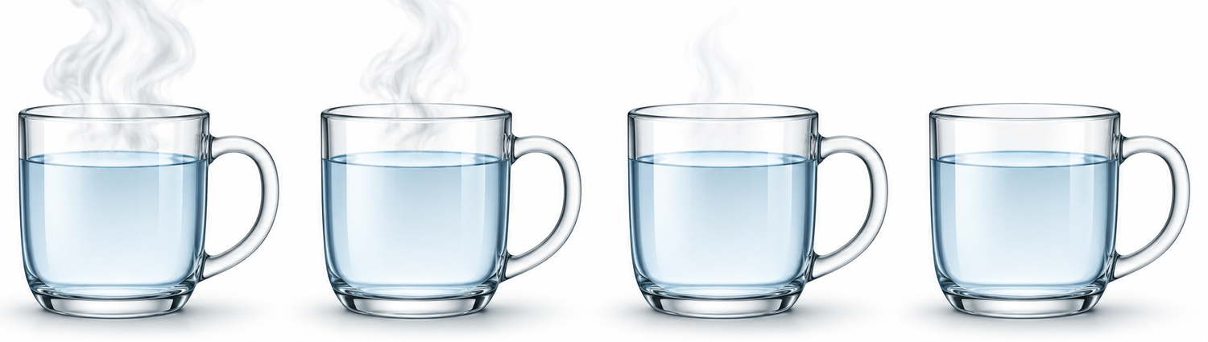
Say the relationship
Complete both sentences.
RELATIONSHIP 1
temperature and seeds germinated
RELATIONSHIP 2
time and water temperature
10 °C
15 °C
20 °C
25 °C
0 s
60 s
120 s
180 s
Temperature (°C) | Percentage of seeds germinated (%)
10 | 20%
15 | 40%
20 | 65%
25 | 90%
Time (s) | Temperature (°C)
0 | 90
60 | 66
120 | 54
180 | 49
As the temperature increases, the percentage of seeds that germinated ___.
As time increases, the water temperature ___.
Say both sentences to your partner.
Notes:
DO (4 min): Teach "As ___ increases, ___ increases / decreases." Learners complete one sentence per card with a partner, then say both aloud (spoken, not on the handout).
ANSWERS: 1 As the temperature increases, the percentage of seeds that germinated increases. 2 As time increases, the water temperature decreases (L5: 90 °C at 0 s, 49 °C at 180 s).
WATCH FOR: "goes up / down" is fine; model "increases / decreases". Ask: "Does the temperature go up or down?"
STRETCH: use "whereas".

Slide 9
Read the model paragraph
Read along with your finger.
RESULTS TABLE
MODEL PARAGRAPH
Temp. (°C) | Seeds (out of 20) | Seeds germinated (%)
10 | 4 | 20%
15 | 8 | 40%
20 | 13 | 65%
25 | 18 | 90%
The results show that there is a relationship between temperature and germination. As the temperature increases, a higher percentage of seeds germinate. For example, at 10 °C only 20% of the seeds germinated, but at 25 °C 90% of the seeds germinated. This suggests that warmer temperatures help seeds to germinate. However, the results do not show what happens above 25 °C, so we cannot say that a higher temperature always helps seeds to germinate. We would need to test more temperatures to find out.
What is it about?
Which figures does the writer use? Are they in the table?
After one week. Example data.
Then talk to your partner.
Notes:
DO (3 min, handout p1): Read the paragraph aloud while learners follow with a finger. Pairs answer: What is it about? (temperature and germination) Which figures? (10 °C, 20%; 25 °C, 90%; both in the table)
SAY: "This is the paragraph you will write. 85 words. Your target is 80–100." Ask: How many sentences? (6)
WATCH FOR: do not label the jobs yet.
LANGUAGE: "does not show" (L6, L7).

Slide 10
Label each sentence
Which job does each sentence do?
F
Finding
E
Evidence
C
Careful conclusion
1
The results show that there is a relationship between temperature and germination.
2
As the temperature increases, a higher percentage of seeds germinate.
3
For example, at 10 °C only 20% of the seeds germinated, but at 25 °C 90% of the seeds germinated.
4
This suggests that warmer temperatures help seeds to germinate.
5
However, the results do not show what happens above 25 °C, so we cannot say that a higher temperature always helps seeds to germinate.
6
We would need to test more temperatures to find out.
Write F, E or C. Colour each sentence.
Notes:
DO (5 min, handout p1): Learners colour each sentence 2–6 in the model paragraph on the handout (sentence 1 is an opening): navy = finding, teal = evidence, plum = careful conclusion. Pairs first; slide 11 checks.
ANSWERS: 1 opening (no job), 2 F, 3 E, 4 C, 5 C, 6 C.
TRY: "Which sentence has numbers? Which say what the results do not show?"
STRETCH: "Does every sentence do a different job?"
PRAISE: "Good detective work."

Slide 11
Check: the three jobs
Each job has its own language.
1 THE FINDING
The results show that there is a relationship between ___ and ___.
As ___ increases, ___ increases / decreases.
The results show that there is a relationship between temperature and germination.
As the temperature increases, a higher percentage of seeds germinate.
2 THE EVIDENCE
For example, at ___, ___, but at ___, ___.
For example, at 10 °C only 20% of the seeds germinated, but at 25 °C 90% of the seeds germinated.
3 THE CAREFUL CONCLUSION
This suggests ___, but the results do not show ___.
We would need more results to find out ___.
This suggests that warmer temperatures help seeds to germinate.
However, the results do not show what happens above 25 °C, so we cannot say that a higher temperature always helps seeds to germinate.
We would need to test more temperatures to find out.
Key idea: finding, then evidence, then a careful conclusion.
Notes:
DO (3 min, handout p1): Reveal: finding = sentences 1–2, evidence = 3, careful conclusion = 4–6. Learners fix their labels, then read each starter aloud.
LANGUAGE: finding: say the relationship first. Evidence: two figures with units. Careful conclusion: This suggests… but the results do not show… We would need more results…
WATCH FOR: "This proves…" or "because" for a cause the results do not show. Redirect: "suggests", "might".
This order is the report order (L9–L10).

Slide 12
Today’s journey
✓
Read the results
Quickfire questions. Key words.
Today’s aims
Study a model paragraph
Content
Find the relationship in results.
✓
Find the three jobs.
Language
Write a results paragraph.
3
Build and improve
Order sentences. Improve evidence.
The results show ___.
For example, ___.
This suggests ___, but ___.
4
Write your paragraph
result · relationship · variable · evidence
Plan. Say. Write. Check.
Skills
Understand how a paragraph is organised.
Notes:
DO (30 sec): Tick step 2: "You have studied a model paragraph and found its three jobs." Point at step 3: "Next, put sentences in order and make evidence precise."
Skeleton slide: do not count or cut.

Slide 13
Build the paragraph
Put the five sentences in the correct order.
This suggests that seeds need warmth to germinate, but it does not show that temperature is the only reason.
RESULTS TABLE
A
Temp. (°C) | Seeds (out of 20) | Seeds germinated (%)
10 | 4 | 20%
15 | 8 | 40%
20 | 13 | 65%
25 | 18 | 90%
The results show a relationship between temperature and germination.
B
Other things, such as water and light, might also be factors.
C
For example, 8 out of 20 seeds germinated at 15 °C, but 18 out of 20 germinated at 25 °C.
D
WRITE THE ORDER
___ ___ ___ ___ ___
When the temperature is higher, more seeds germinate.
E
Think: finding, evidence, careful conclusion.
factor = something that can affect a result
Look for the starters from slide 11.
Notes:
DO (5 min, handout p3): Pairs put five sentences about the same seed table in order, then write the letters on the handout.
ANSWER: B, E, D, A, C.
TRY: "Which phrases start each job?" Point to slide 11 if stuck.
CHECK: 8 out of 20 = 40%; 18 out of 20 = 90%.
LANGUAGE: factor = something that can affect a result. "Water and light are factors."
SUPPORT: cut-up sentence strips.
STRETCH: say the paragraph in order without reading.

Slide 14

Check: the correct order
What helped you decide?
The results show a relationship between temperature and germination.
LOOK FOR
B
FINDING
The results show …
For example, …
This suggests …, but …
… might also be factors.
When the temperature is higher, more seeds germinate.
E
FINDING
For example, 8 out of 20 seeds germinated at 15 °C, but 18 out of 20 germinated at 25 °C.
D
EVIDENCE
This suggests that seeds need warmth to germinate, but it does not show that temperature is the only reason.
A
CAREFUL CONCLUSION
Other things, such as water and light, might also be factors.
factor = something that can affect a result
C
CAREFUL CONCLUSION
Key idea: say what else might be a factor.
Notes:
DO (2 min): Reveal B, E, D, A, C with job labels. Ask: "What helped you decide?" (The results show… For example… This suggests… but… …might also be factors.)
WATCH FOR: sentence C is also a careful conclusion: say what else might be a factor (as in L7).
TRY: if a pair's order differs, ask them to read it aloud. Does it still read well? Good reasons are fine.
CHECK: 8 ÷ 20 × 100 = 40%.

Slide 15


Make the evidence more precise
Rewrite the weak sentence. Use exact figures.
WEAK EVIDENCE
RESULTS TABLE
Temp. (°C) | Seeds (out of 20) | Seeds germinated (%)
10 | 4 | 20%
15 | 8 | 40%
20 | 13 | 65%
25 | 18 | 90%
A lot of seeds germinated when it was warm, but not many germinated when it was cold.
How many is “a lot”? How warm is “warm”?
YOUR TURN
Choose two relevant figures from the table.
For example, at ___ °C, ___% of the seeds germinated, but at ___ °C, only ___%.
precise = exact and clear
relevant = connected to your point
Key idea: precise figures are better evidence.
Notes:
DO (5 min, handout p2): Learners rewrite the weak sentence on the handout or mini-whiteboards using TWO figures. Say: "It is not wrong, but it is not precise."
ANSWER: For example, at 10 °C only 20% of the seeds germinated, but at 25 °C 90% germinated. Accept any two figures that show the difference.
TRY: "How many is a lot? How warm?"
LANGUAGE: precise = exact and clear; relevant = connected to your point.
SUPPORT: the frame. STRETCH: two different sentences.

Slide 16
Check: is the evidence precise?
Compare your sentence with these.
✓
GOOD EVIDENCE
For example, at 10 °C only 20% of the seeds germinated, but at 25 °C 90% of the seeds germinated.
✗
TOO MUCH
At 10 °C, 20% of the seeds germinated. At 15 °C, 40% germinated. At 20 °C, 65% germinated. At 25 °C, 90% germinated.
All true, but too many numbers. Two figures show the difference.
Key idea: choose the figures that show the difference.
Notes:
DO (2 min): Show the example; learners compare. Say: "All four sentences are true, but the reader must look at eight numbers."
TRY: "Why 10 °C and 25 °C?" (lowest and highest: the biggest difference)
WATCH FOR: two figures, units, and "but" or "whereas".
LANGUAGE: choose figures that show the difference (L3: do not list every number).

Slide 17
Today’s journey
✓
Read the results
Quickfire questions. Key words.
Today’s aims
Study a model paragraph
Content
Find the relationship in results.
✓
Find the three jobs.
Language
Write a results paragraph.
✓
Build and improve
Order sentences. Improve evidence.
The results show ___.
For example, ___.
This suggests ___, but ___.
4
Write your paragraph
result · relationship · variable · evidence
Plan. Say. Write. Check.
Skills
Understand how a paragraph is organised.
Notes:
DO (30 sec): Tick step 3: "You have put a paragraph in order and made evidence precise." Point at step 4: "Your turn: a new investigation. Plan, say, write, check."
Skeleton slide: do not count or cut.

Slide 18
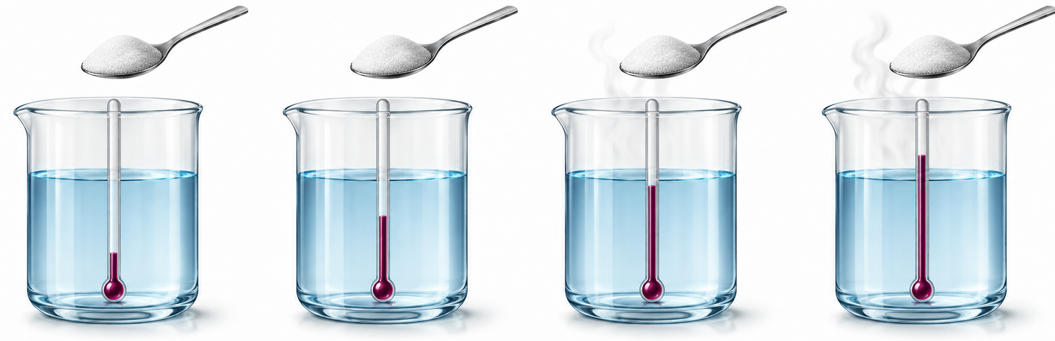
A new investigation
A student tests sugar in water at four temperatures.
20 °C
40 °C
60 °C
80 °C
DISSOLVE
dissolve (verb)
The sugar dissolved.
She timed how long it took.
mix into a liquid so you cannot see it
What is different? What is the same?
Notes:
DO (3 min): Same routine as slide 3. Pictures only. Read: "A student put one teaspoon of sugar (about 5 g) in 100 ml of water at four temperatures, stirred it the same way each time, and timed how long it took to dissolve." Ask: What is different? (water temperature) What is the same? (sugar, water, stirring)
LANGUAGE: dissolve = mix into a liquid so you cannot see it. Demonstrate with a glass and a spoon.

Slide 19
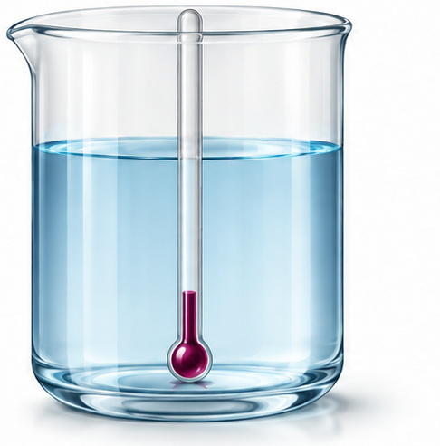
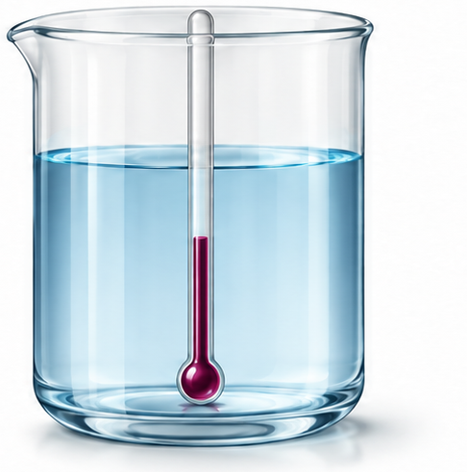
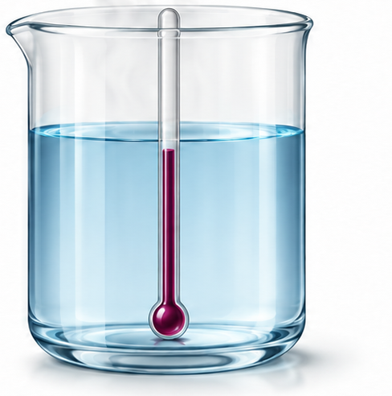
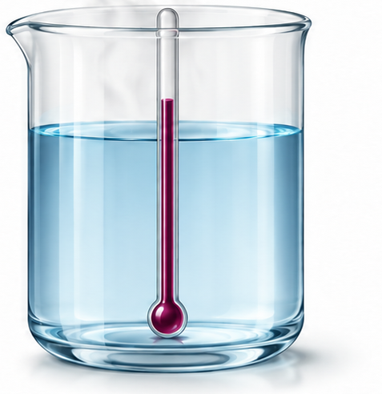
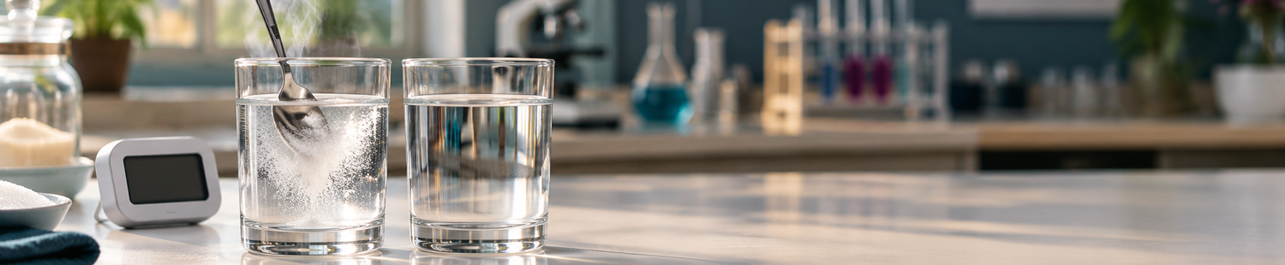
Talk and predict
Talk first. Then predict.
TURN AND TALK
What is the student testing?
20 °C
40 °C
60 °C
80 °C
1
TIME TO DISSOLVE (SECONDS)
 | 20 °C | 40 °C | 60 °C | 80 °C
My prediction (s)
What changes? What stays the same?
2
Predict. The table is empty.
How long might the sugar take at each temperature?
3
Say: At ___ °C, the sugar might take ___ seconds.
Notes:
DO (3 min): Same routine as slide 4. Pairs talk, then predict seconds in the empty table.
ANSWERS: 1 She is testing if water temperature changes how fast sugar dissolves. 2 Temperature changes (20, 40, 60, 80 °C); sugar, water and stirring stay the same. 3 Any sensible numbers; "might".
STRETCH: Why the same amount of sugar and water? (a fair comparison)
Do not give the numbers yet.

Slide 20
Plan, then say it
Read the table. Plan your three jobs.
SUGAR INVESTIGATION
1 FINDING
What is the relationship between ___ and ___?
20 °C
40 °C
60 °C
80 °C
There is a relationship between ___ and ___.
A student put one teaspoon of sugar in 100 ml of water at four temperatures. She timed how long it took to dissolve.
2 EVIDENCE
Which two figures show the difference?
Water temperature (°C) | Time to dissolve (s)
20 | 30
40 | 18
60 | 10
80 | 5
For example, at ___, ___, but at ___, ___.
3 CAREFUL CONCLUSION
What do the results not show?
Example data.
This suggests ___, but the results do not show ___.
Plan on your handout. Then say them to your partner.
Notes:
DO (6 min, handout p4): Learners read the table and plan the three jobs aloud with a partner (the data is on the handout) (finding clear? two figures? something the results do not show?).
ANSWERS: 1 as water temperature increases, time decreases. 2 e.g. 20 °C, 30 s and 80 °C, 5 s. 3 e.g. above 80 °C; other sugars; stirring.
WATCH FOR: "increases" for the time. Ask: "Does the time go up or down?"
STRETCH: a second figure.

Slide 21
Write your paragraph
80–100 words. Use your plan and the frame.
The results show that there is a relationship between ___ and ___.
SUGAR INVESTIGATION
Finding
Water temp. (°C) | Time to dissolve (s)
20 | 30
40 | 18
60 | 10
80 | 5
As ___ increases, ___ increases / decreases.
Finding
For example, at ___, ___, but at ___, ___.
Evidence
This suggests ___, but the results do not show ___.
Careful conclusion
TARGET
80–100 words
We would need more results to find out ___.
Careful conclusion
Stronger writers: cover the frame.
Finding, then evidence, then a careful conclusion.
Notes:
DO (14 min, handout p4): Learners write 80–100 words about the sugar investigation from their plan and the frame.
WATCH FOR: time DEcreases; two figures with units; "suggests", "might", "do not show"; the order; "but". Common errors: "because", "proves", listing four numbers.
SUPPORT: the frame. STRETCH: cover the frame; add another thing the results do not show.
Learners count words and write the number in the box. Do not mark spelling.

Slide 22
A model answer
Compare your paragraph with this one.
FINDING
The results show that there is a relationship between water temperature and the time sugar takes to dissolve. As the temperature increases, the time decreases.
EVIDENCE
For example, sugar took 30 seconds to dissolve at 20 °C, but only 5 seconds at 80 °C.
CAREFUL CONCLUSION
This suggests that sugar dissolves faster in hotter water. However, the results do not show what happens above 80 °C, so we cannot say that a higher temperature always helps sugar to dissolve faster. We would need to test more temperatures to find out.
Did you write all three jobs?
Notes:
DO (3 min, optional): Show AFTER writing. Learners compare: same three jobs? Which two figures? What do your results not show? (87 words)
TRY: it is not the only answer. 40 and 60 °C, or stirring, are fine. Do not copy.
LANGUAGE: As … increases, … decreases. For example, … but only … This suggests … However, the results do not show … We would need to test … to find out.
Skip if time is short.

Slide 23

Check and improve your paragraph
Check it. Swap with a partner. Improve one sentence.
STEP 1 · CHECK
WORD COUNT
Finding
Did I say the relationship?
Count your words.
Target: 80–100.
Evidence
Did I use two figures, with units?
Careful conclusion
Did I say what the results do not show?
STEP 2 · SWAP
BACK TO THE QUESTION
Swap. Say one good thing and one thing to improve.
What can a set of results tell us?
What can’t they tell us?
STEP 3 · IMPROVE
Write one better sentence.
Key idea: a careful writer says what the results show and what they do not show.
Notes:
DO (8 min, handout p5): Step 1: check against the three questions. Step 2: swap; the partner says ONE thing that works and ONE to improve. Step 3: improve ONE sentence on the handout. If short on time, drop step 2.
CLOSE (1 min): "What can a set of results tell us? What can't they?" (a relationship; not other conditions or other reasons)
Link: the Data report uses the same order.
PRAISE: "Careful writing."

Slide 24
Self-study: record new vocabulary
Complete the table, or use the Frayer model.
Word | Translation | Meaning | Word forms | Example sentence | Collocations
relationship | ความสัมพันธ์ | a connection between two variables | relationship (noun), related | There is a relationship between temperature and germination. | a close relationship, find a relationship
result
variable
evidence
Do result, variable and evidence. Use a dictionary or a partner.
Notes:
DO (optional, end or home): Learners complete the table for result, variable and evidence; relationship is the model row.
ANSWERS: result = what you find out from an investigation. variable = something that can change (Temperature is a variable). evidence = facts and numbers that support a point.
LANGUAGE: learners write their own language. Check the Thai (ความสัมพันธ์) with a Thai speaker.

Slide 25
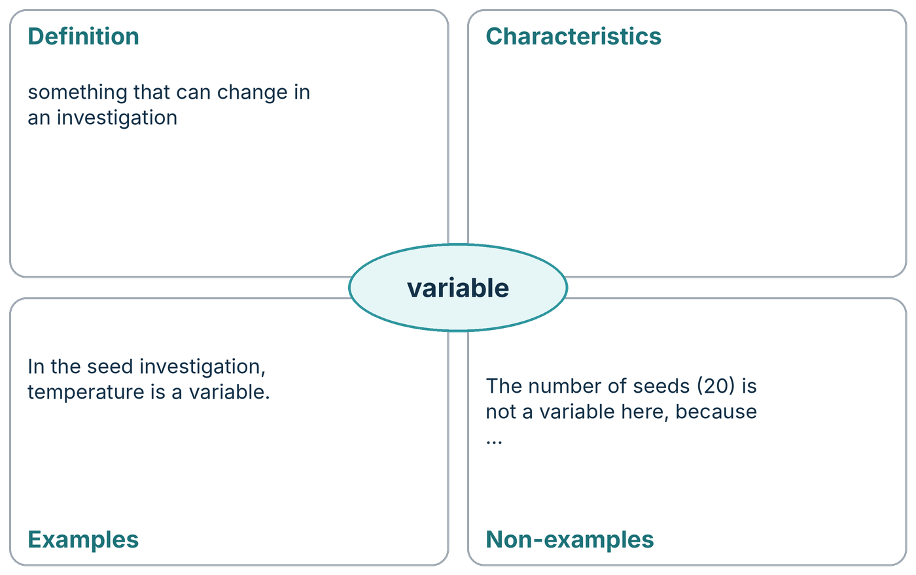
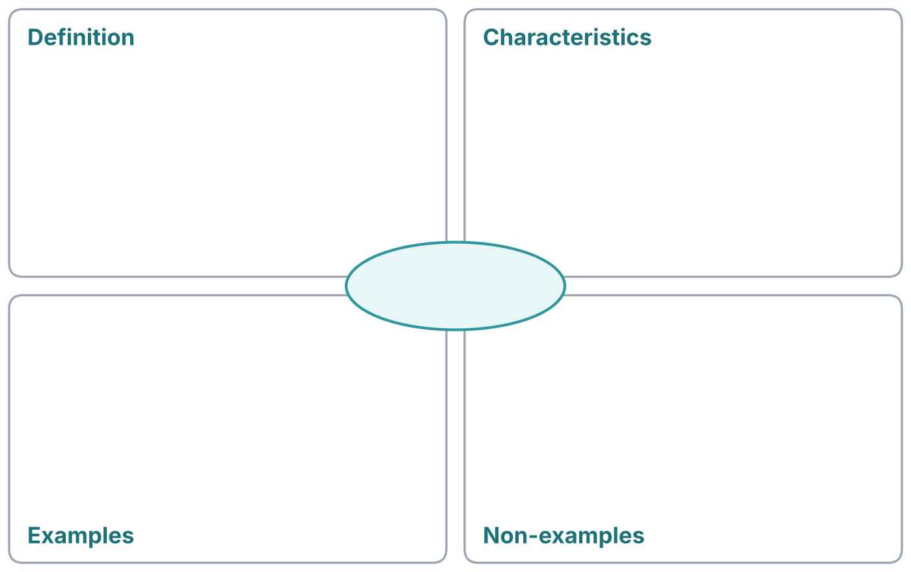
Self-study: Frayer model
Finish one model. Then make your own.
Finish this model
Now make your own
Choose one: result · relationship · evidence
Notes:
DO (optional): Choose the table OR the Frayer, not both. Left: finish "variable" (it can change; you can measure it; the 20 seeds are a non-example because they do not change). Right: a blank Frayer for result, relationship or evidence.
LANGUAGE: any language in the definition box.
STRETCH: an example sentence from today's investigations.

