Slide 1
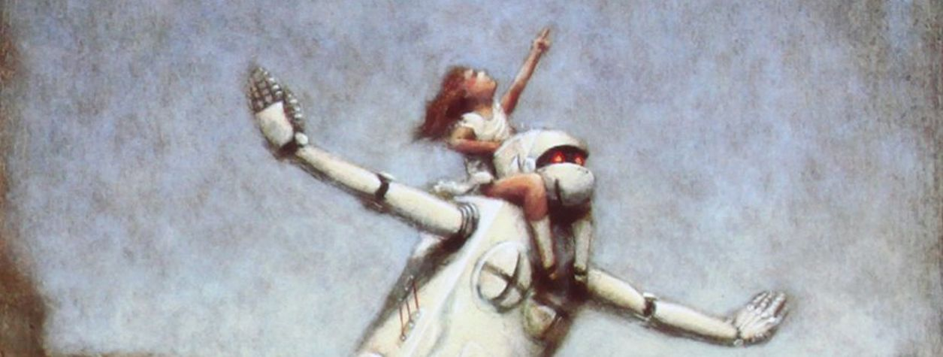
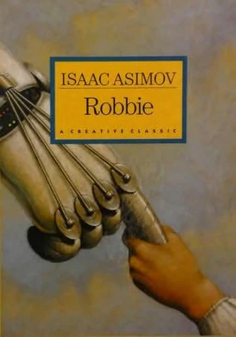

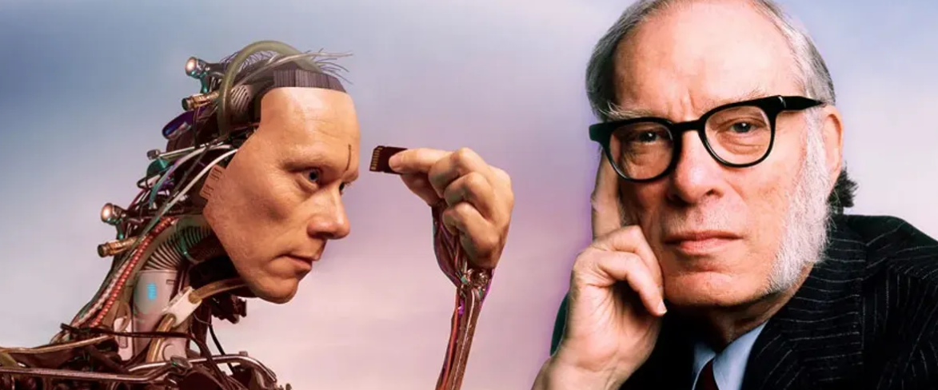
ROBBIE
Our short story for Term 1b

Slide 2
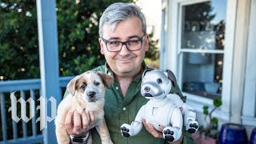
Our new topic is about robots. Check out this robot!
Would you like one? Why / Why not?

Slide 3
Which dog…
Costs more? Aibo Lola
Runs faster? Aibo Lola
Needs more training? Aibo Lola
Is an indoor-only breed? Aibo Lola

Slide 4
Answer the questions, then watch again and check your answers.
How does Aibo learn? Is this different to the way Lola learns?
Where does Aibo get new tricks?
How long can Aibo play before it needs charging?
Why would Aibo make a good spy?

Slide 5
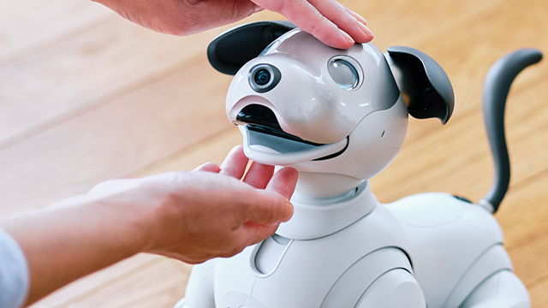
‘Aibo has 2 cameras and 4 microphones…’
How do you feel about this?

Slide 6
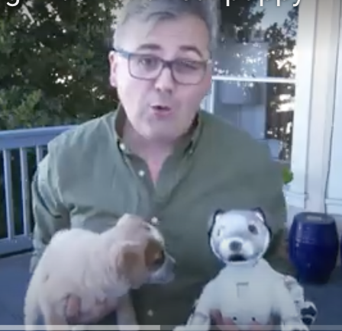
Overall, which would you prefer? Why?
AIBO
LOLA

Slide 7
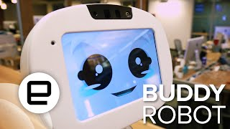
Would you like a friend like Buddy? Why / Why not?

Slide 8
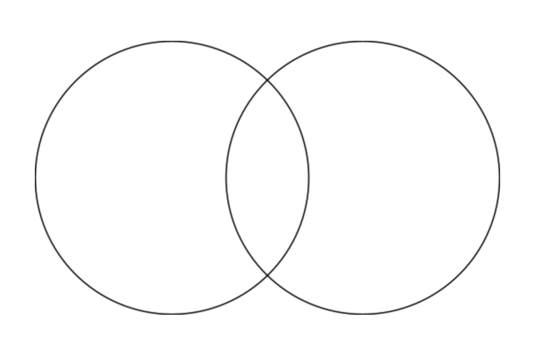
Buddy the Robot vs a human buddy
Buddy
Human

Slide 9
Buddy the Robot vs a human buddy
Buddy
Human
Buddy is/can/has _______________________, whereas a human friend ___________
Both a human friend and Buddy ___________________________________________

Slide 10
Free write
Do you think that robotic animals or robotic friends could ever replace real living things? Explain your answer.

Slide 11
Reminder
Share 3 facts about Aibo
Share 2 things that both Aibo and real dogs can do
Share 2 things that Buddy can do

Slide 12
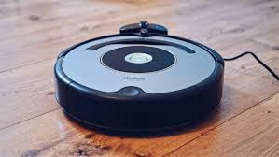
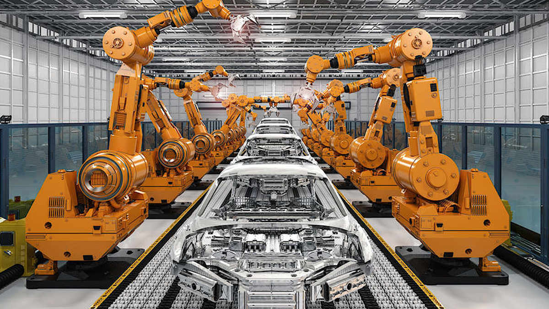
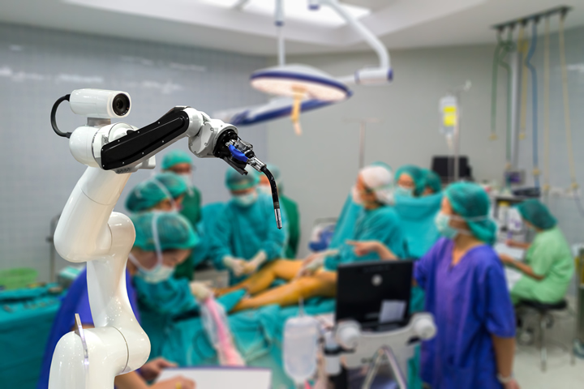
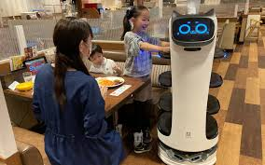
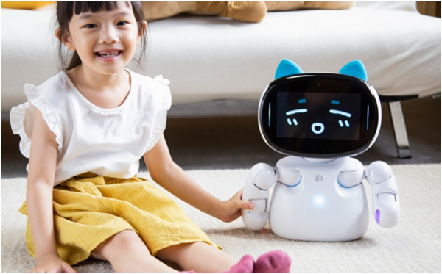
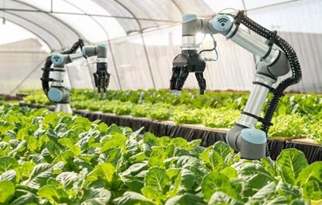
List 10 different ways that we use robots to assist (help) us. Use the images for ideas.

Slide 13
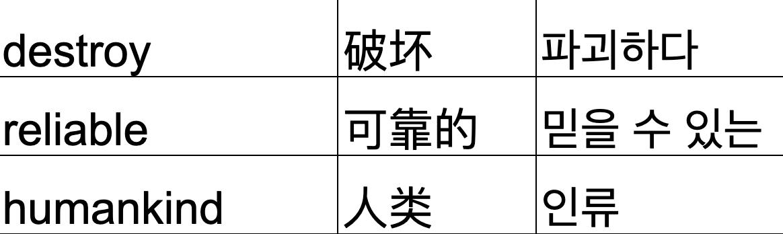
Which statements do you agree/disagree with? Why?
1
2
Robots take jobs away from humans
Robots will never think like humans
I agree with statement 1, because…
I disagree with statement 3, because…
3
Robots are more reliable than humans
4
Robots will destroy humankind

Slide 14
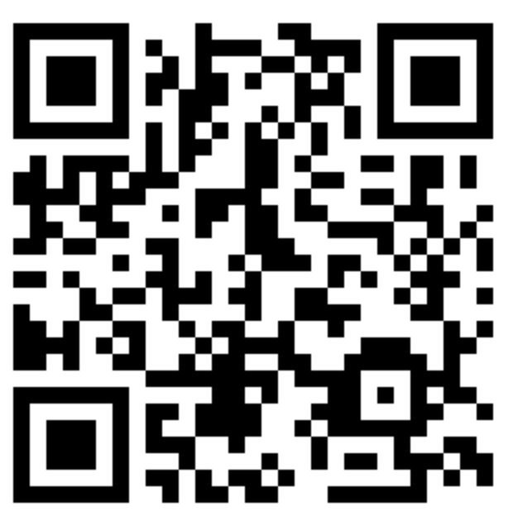
Read each sentence. Guess the meaning of the word in blue.
He won’t arrive on time. He’s not reliable.
Ms Williams is Head of Year 8. She is responsible for the wellbeing of Year 8 students.
I would tell her all my secrets. I trust her.
After his accident, he lost the ability to walk.
The students just play games on their phones. They don’t interact with each other.
After her husband died, she bought a dog for companionship.
My mobile phone screen is cracked. I need a replacement.
https://wordwall.net/resource/80210477

Slide 15

Record new vocabulary
Word / translation | Meaning | Example
reliable | can be trusted to do something | He will arrive on time - he is reliable.

Slide 16
Some questions
Which of your classmates is the most reliable?
What is Mr Merrett responsible for?
Which would be worse: losing the ability to walk or to talk?
Who do you interact with at break times?
Who would you trust with your secrets?

Slide 17
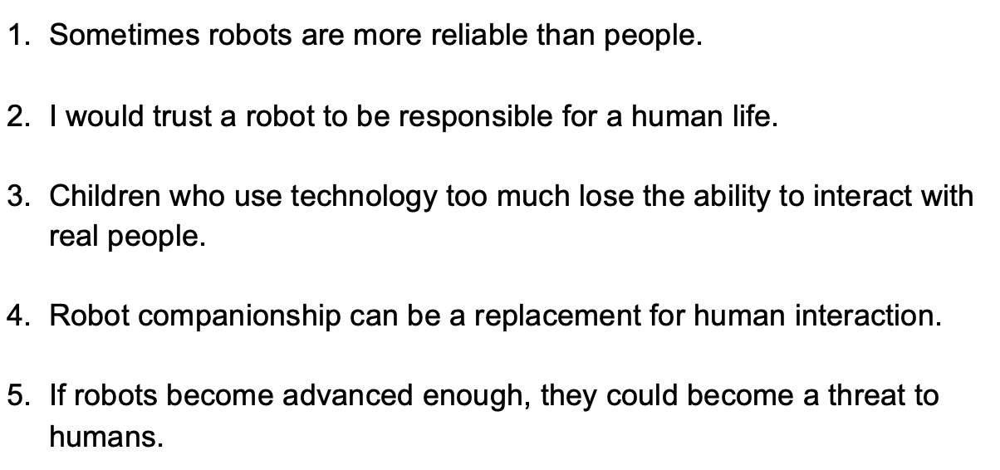
Back to robots. Do you agree or disagree with these statements? Why?

Slide 18
Choose one statement. Write it in your book. Respond in your own words (30 words minimum).

Slide 19
Which of these tasks would you trust a robot to do?
Clean your house
Look after a pet
Look after an elderly relative who is sick
Do your homework
Fight for your country in a war
Cook dinner
Teach you English
Perform open heart surgery
I would trust a robot to ______ because…
I wouldn’t trust a robot to_______ because…
I don’t know if I would trust a robot to _______
I certainly wouldn’t trust a robot to _____________

Slide 20
Add one more task you would / wouldn’t trust a robot to do.
Clean your house
Look after a pet
Look after an elderly relative who is sick
Do your homework
Fight for your country in a war
Cook dinner
Teach you English
Perform open heart surgery
Your idea: ______________________
I would trust a robot to ______ because…
I wouldn’t trust a robot to_______ because…

Slide 21
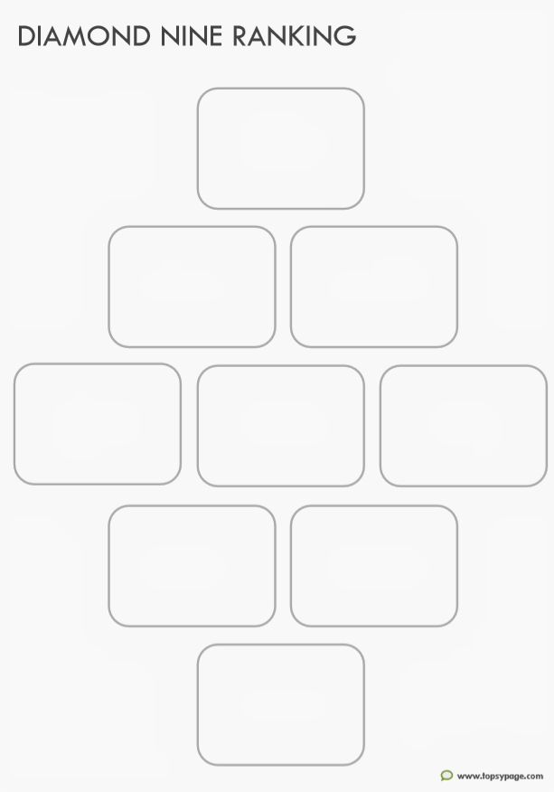
Rank the tasks based on which you would trust a robot to do.
Clean your house
Look after a pet
Look after an elderly relative who is sick
Do your homework
Fight for your country in a war
Cook dinner
Teach you English
Perform open heart surgery
Your idea: ______________________

Slide 22
Example:
Clean the house
You would definitely trust a robot to do this
You wouldn’t trust the robot to do this at all!
Cook dinner

Slide 23
Be ready to share ideas with a partner
Clean the house
You would definitely trust a robot to do this
I wouldn’t trust a robot to cook because they don’t eat! They won’t understand what good food tastes like.
You wouldn’t trust the robot to do this at all!
Cook dinner

Slide 24
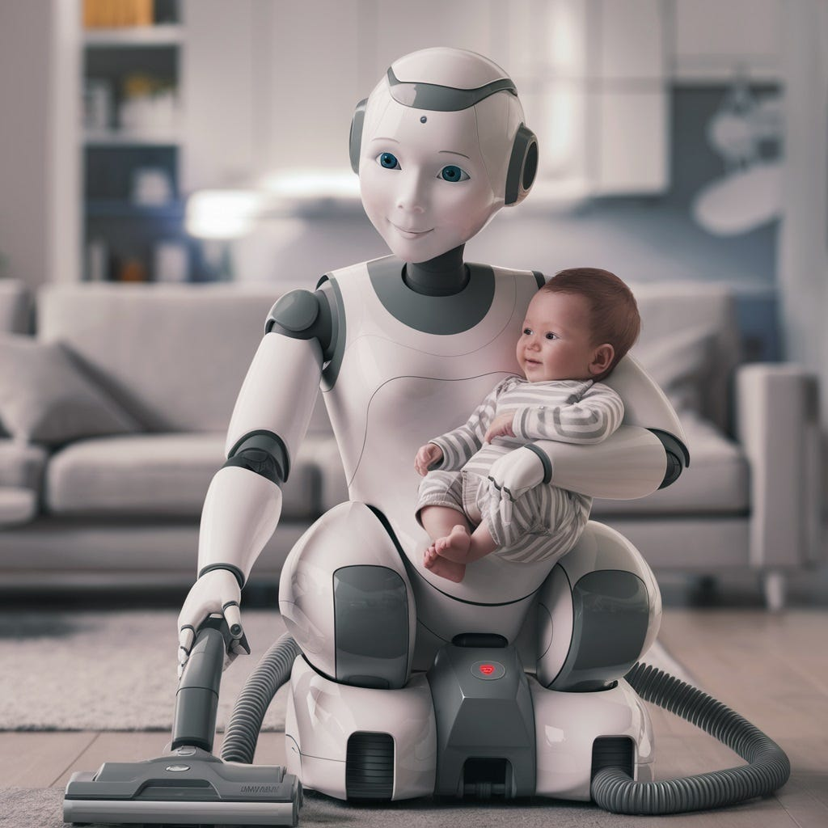
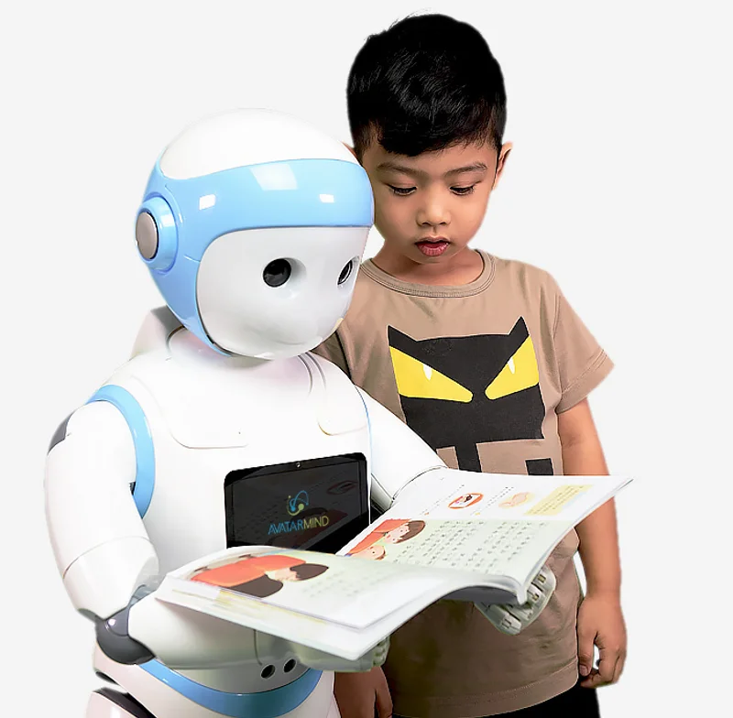
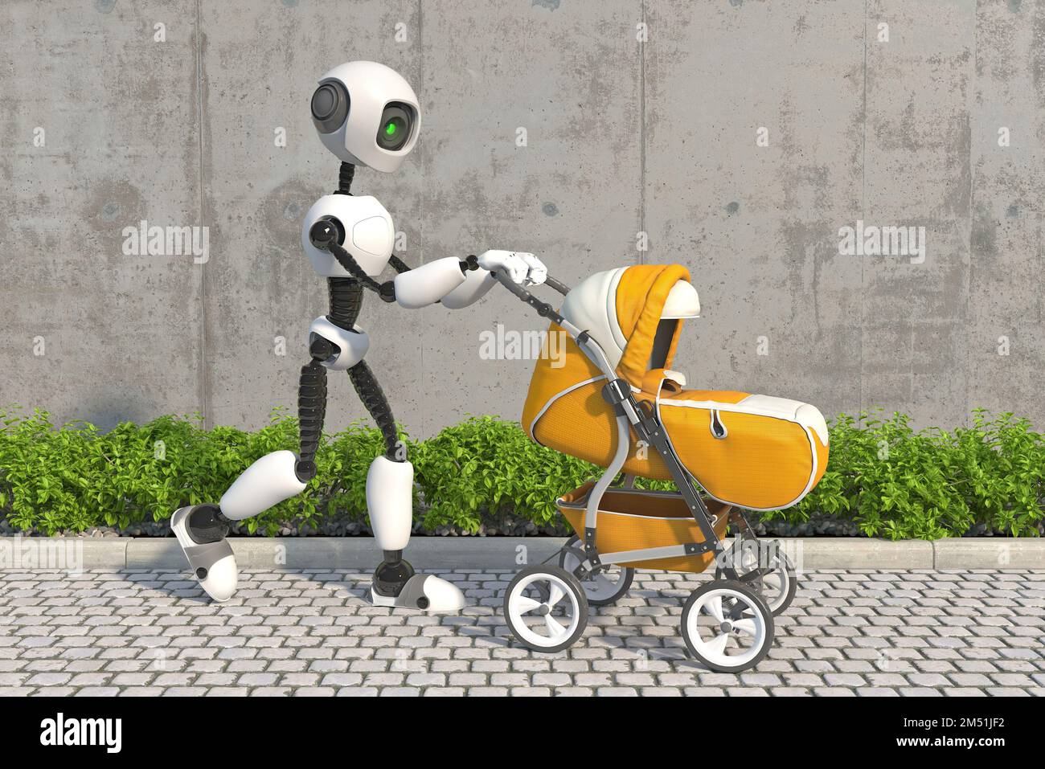
What about a robot nanny?
Would you trust a robot to look after children?

Slide 25
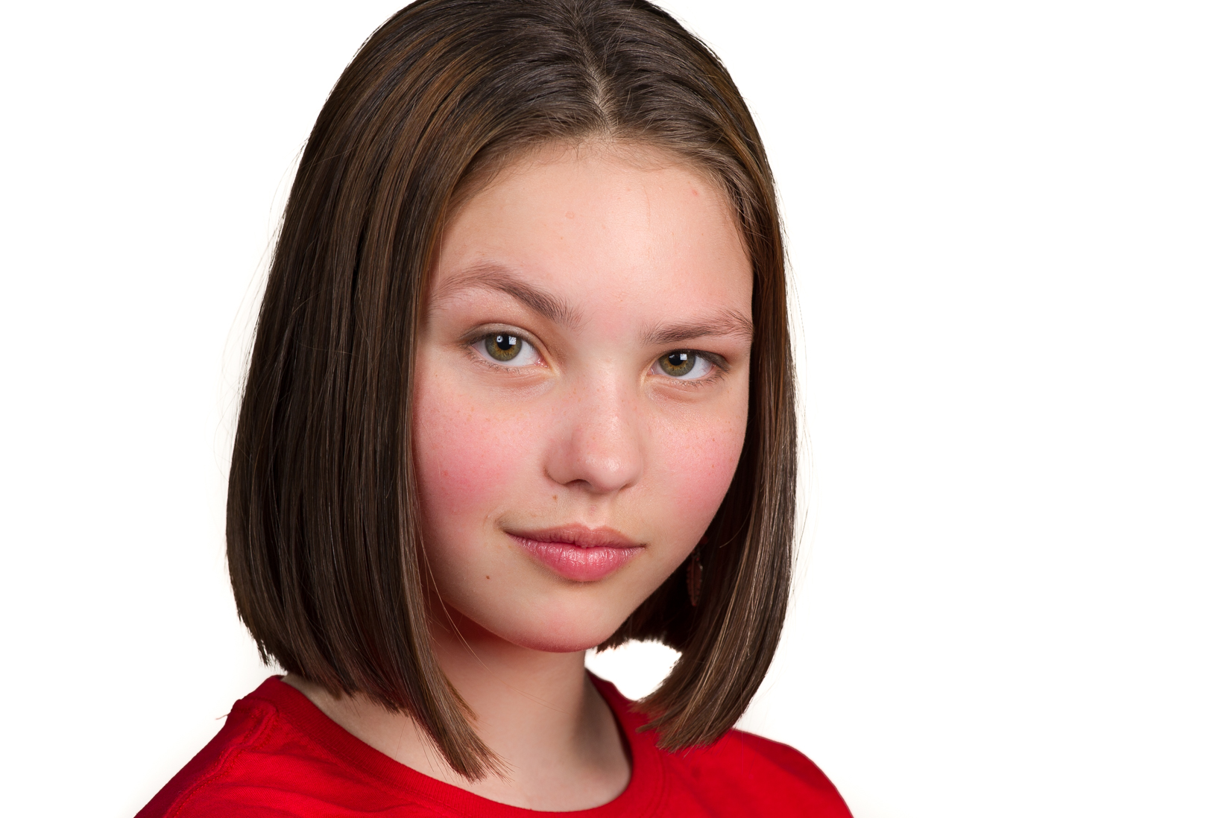
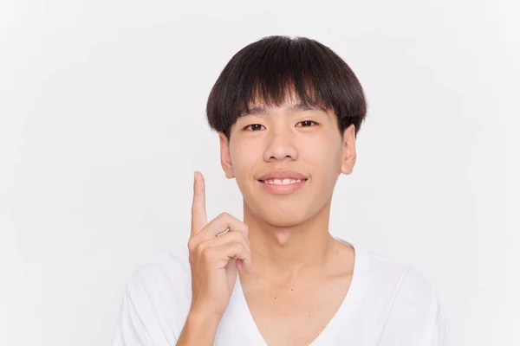
Who do you agree with more? Why?
But if a child spends all its time with a robot, it won’t form connections with its parents
Robots don’t get tired! Real nannies do. You could use a robot nanny 24/7, then the parents would get to relax. Great!
Tina
Kim

Slide 26
Benefits of a robot nanny | Drawbacks / dangers of a robot nanny
They don’t get tired. They could work 24/7 if they have good battery power.
Robots are metal. They can’t give good cuddles!
The child won’t bond (make connections) with their parents if robot nannies are used too often.

Slide 27
Roleplay
Student A: You are Student B’s parent. You have decided to hire a robot nanny to look after them. Explain this to Student B. You should mention the following.
Why you have decided to hire a robot nanny
The things that the robot nanny will do, and what it will help Student B with.
How much time Student B will spend with the robot nanny.
Student B: Your parents have something to tell you. You’re not happy about what they say. Tell them why, and try to change their mind.

Slide 28
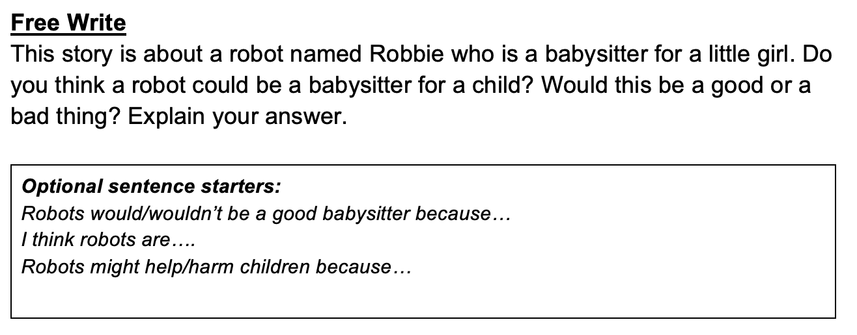

Slide 29
Look at these images for the book Robbie. Do you think the story will be positive or negative? Explain your thinking.

Slide 30
Before we start, let’s learn about the author.
Isaac Asimov (1920–1992) Russian-born American author and biochemist,
Renowned (famous and respected) science fiction and popular science writer.
He is best known for his Foundation series and the Three Laws of Robotics.
Asimov's work explored themes of technology and ethics.
Ethics:
Moral principles that influence our behaviour.

Slide 31
Before we start, let’s learn about the author.
Isaac Asimov made lots of predictions about the future which have since come true!
The rise of computers and the internet as essential tools
Advanced AI and robotics
Space exploration
Biotechnology and genetic engineering
Very smart!

Slide 32
Asimov’s Three Laws of Robotics
In 1942, Asimov outlines three laws to ensure that people were safe from robots.
These laws are important for us to know before we read the book.

Slide 33
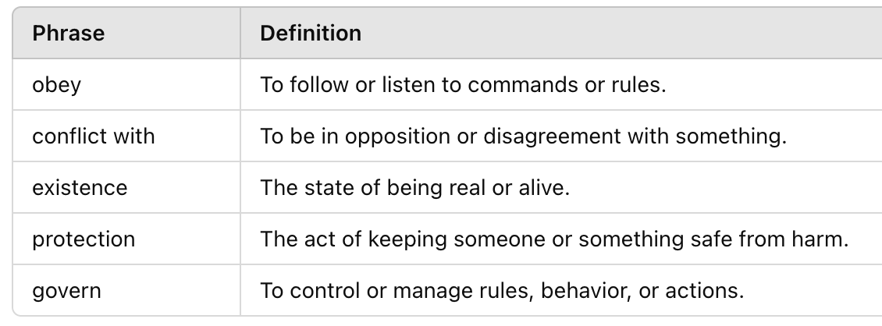
Asimov’s Three Laws of Robotics
Student A: runner.
Student B: writer.
Some words you need to know first.

Slide 34
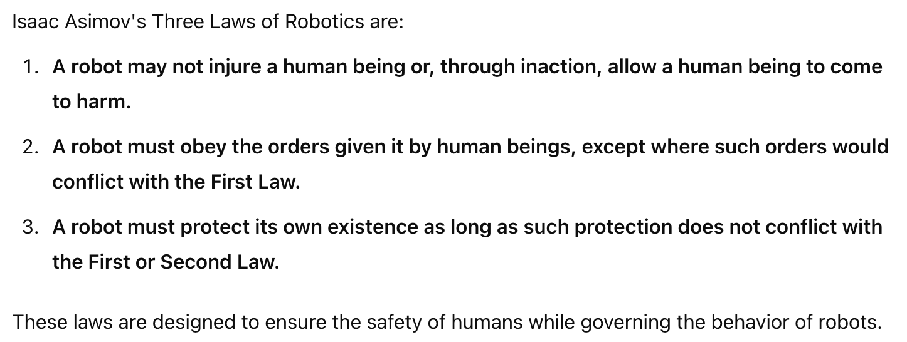
Asimov’s Three Laws of Robotics
Student A: runner.
Student B: writer.

Slide 35
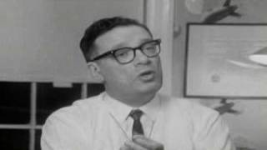

Slide 36
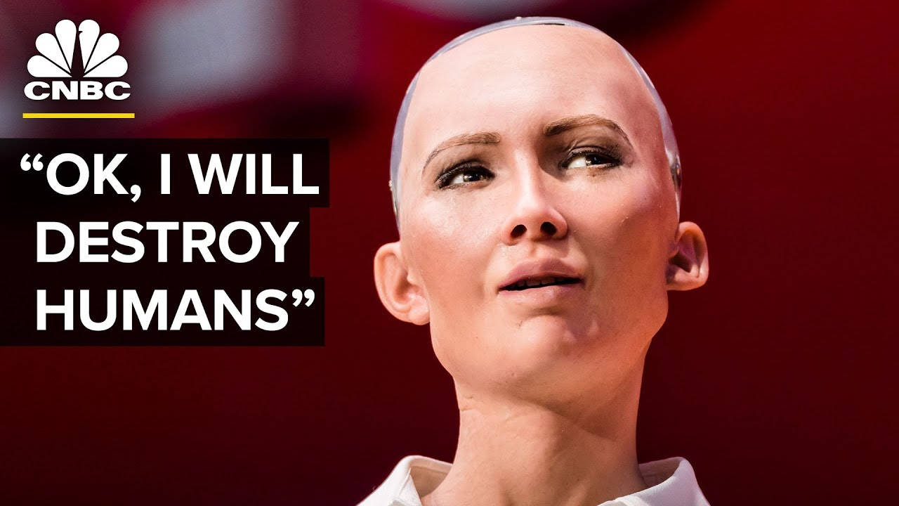
Read these scenarios. How does each robot break the laws of robotics?
An evil human tells a robot to destroy another group of people.
The robot says… ‘OK’.
This robot breaks the ________ law of robotics, which says that __________________. Even though they are following orders, which the _________ law of robotics says they should, the orders are in conflict with _________________________.

Slide 37
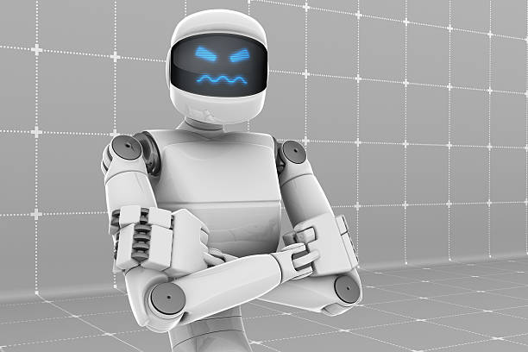
Read these scenarios. How does each robot break the laws of robotics?
A human laughs at a robot and calls him ‘No nose Norman’. The robot gets angry and punches the human in the nose.
This robot breaks the ________ law of robotics, because…

Slide 38
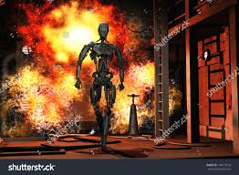
Read these scenarios. How does each robot break the laws of robotics?
A robot is in a burning building. As they run to the exit, they pass an injured human shouting ‘help me!’. They could carry them out. Instead, they decide to escape the building alone.
This robot breaks the ________ law of robotics, because…

Slide 39
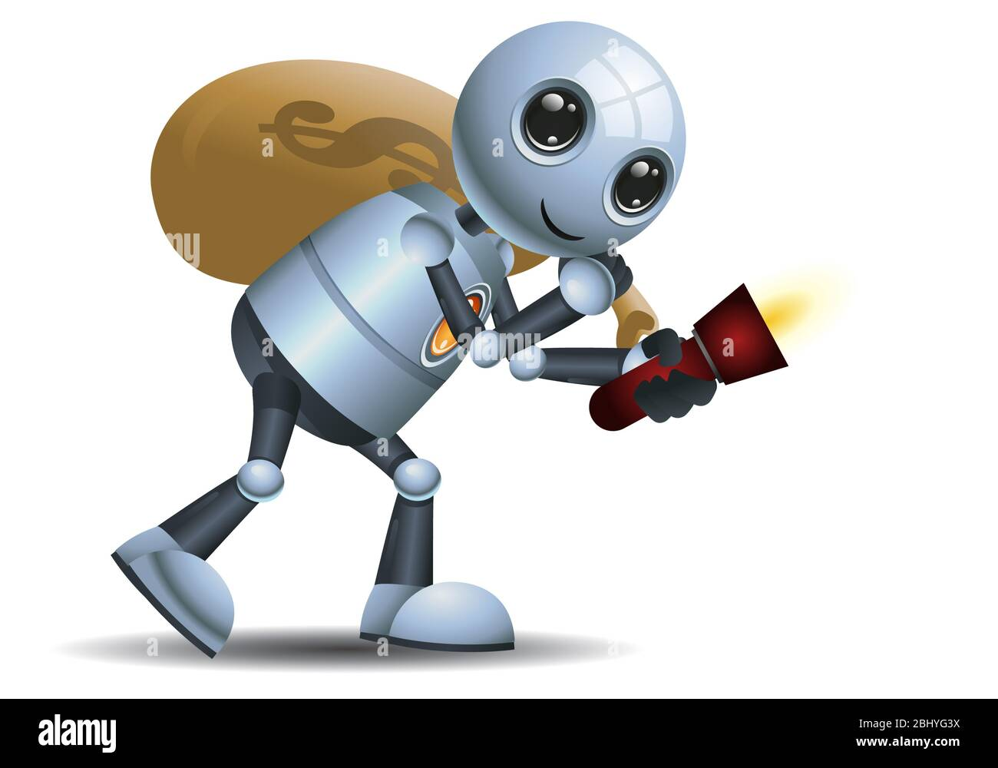
Read these scenarios. How does each robot break the laws of robotics?
A robot helps another human rob a bank. This makes the human rich. After buying a new house and a car, the human gives most of the money they stole to charity to help the poor.

Slide 40
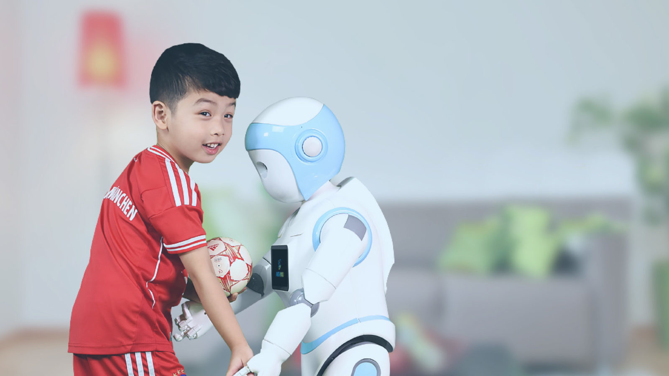
Read these scenarios. How does each robot break the laws of robotics?
A robot nanny is playing football with the boy it cares for. The robot accidentally treads on the boys toe and makes it bleed.

Slide 41
What should be each robots’ punishment? Should there be punishment for any of the humans involved?
Example punishments:
Deactivated for 3 days
Broken into small pieces
Factory reset

Slide 42
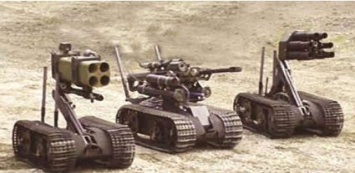
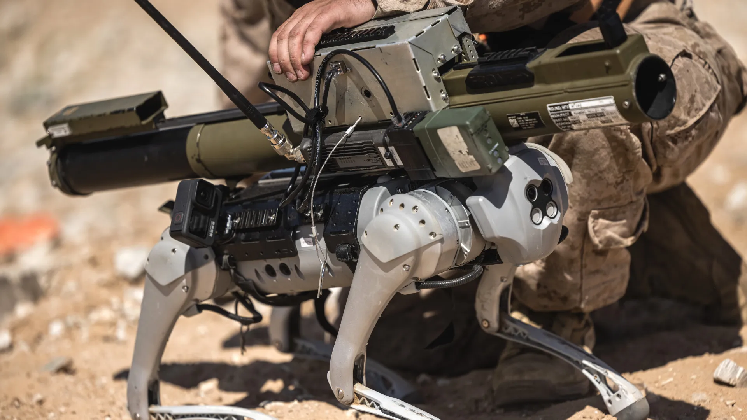
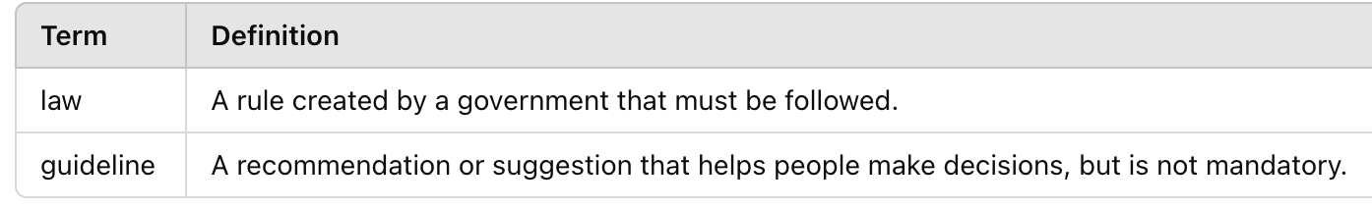
To what extent do humans follow Asimov’s Laws of Robotics?

Slide 43
Should robots have rights?
Rights are things people are allowed to do or have, like the freedom to speak, the right to privacy, and the right to be treated equally.
Yes, I think robots should have rights like humans do, because…
No, I don’t think robots should have rights because…

Slide 44
What guidelines would you introduce to ensure…
Fair use of robotics | The rights of robots
Robots shouldn’t be used for…
Robots should be allowed to…
Humans shouldn’t…

Slide 45
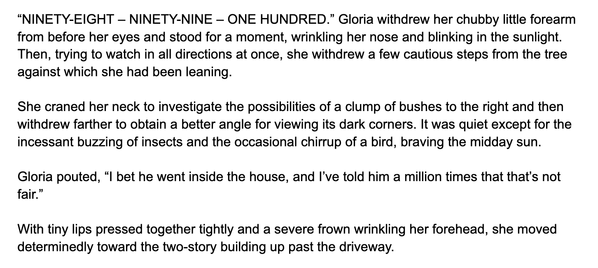
Robbie - Chapter 1
What do you think Gloria and Robbie are doing?

Slide 46
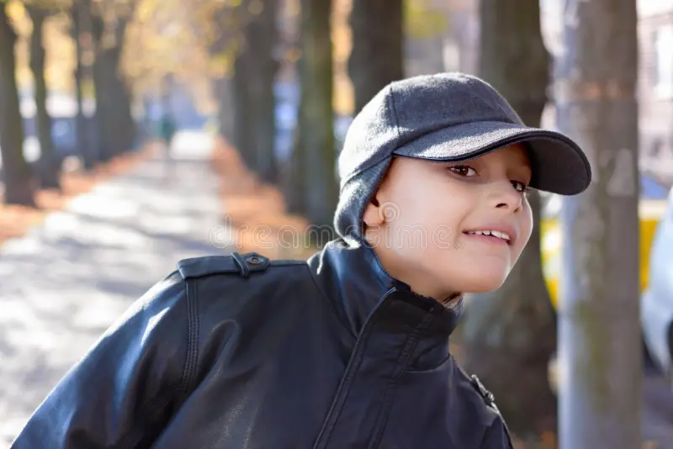
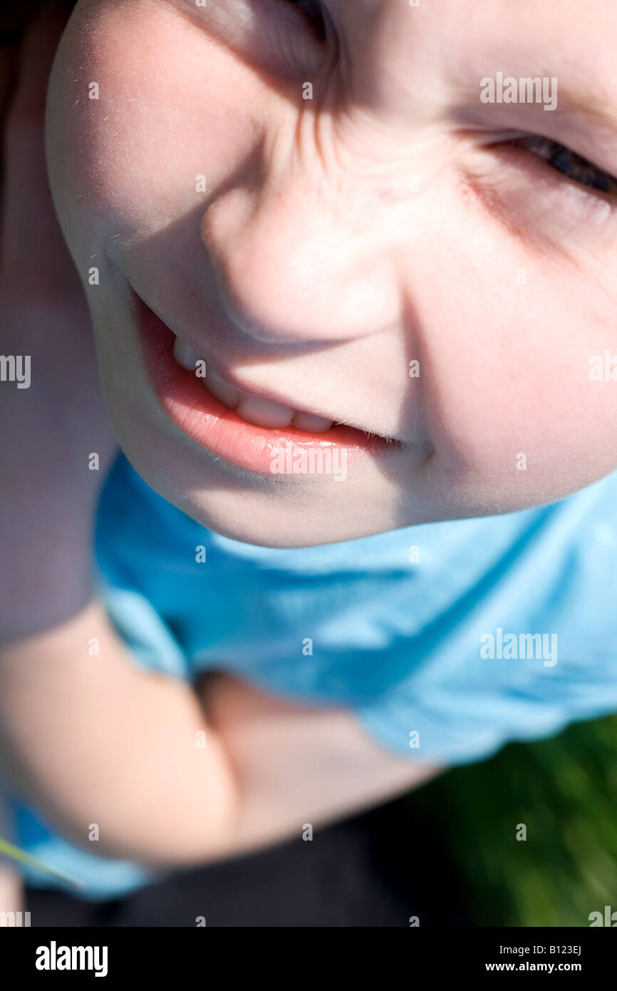
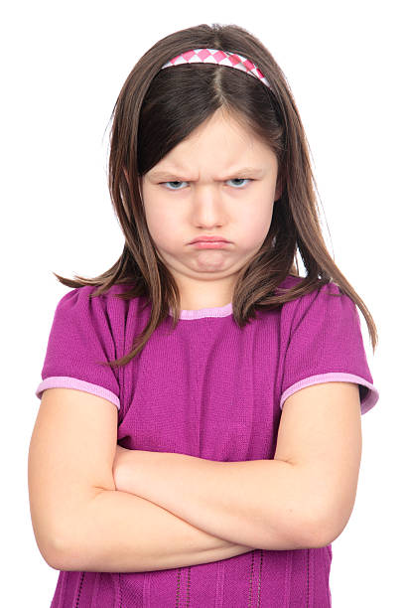
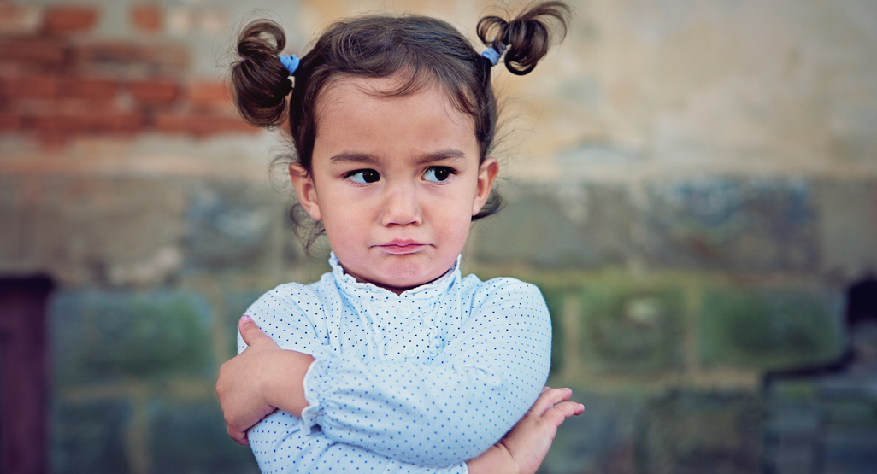
Here are some of Gloria’s actions. Find the phrase in the text which describes them.

Slide 47
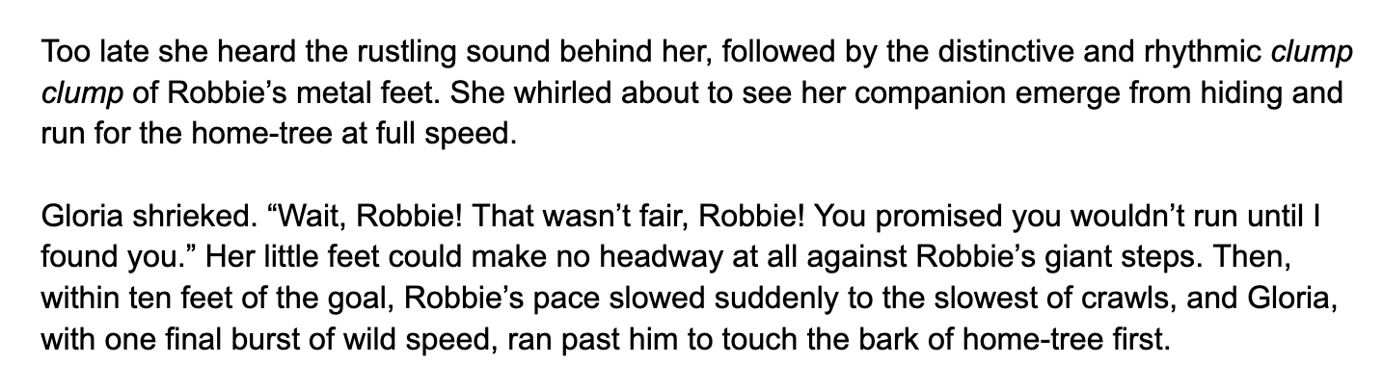
New words

Slide 48
Why do you think Robbie slowed down?

Slide 49
Find a phrase which means:
Different from others; unique
friend
Make no progress, but try to

Slide 50
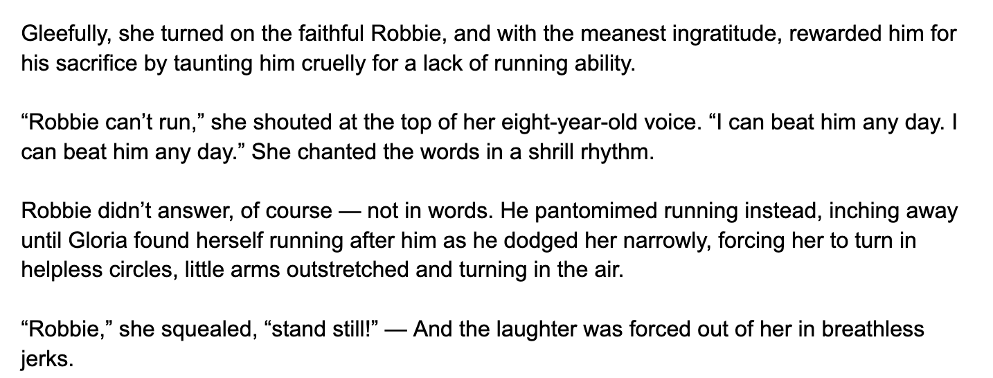
New words

Slide 51
What does Gloria’s taunting of Robbie tell us about their relationship?

Slide 52
Find a phrase which means:
Not being thankful for someone’s kindness
Avoid someone by moving away from them quickly

Slide 53
Who is Robbie?
Who is Gloria?
What has happened in the story so far?

Slide 54
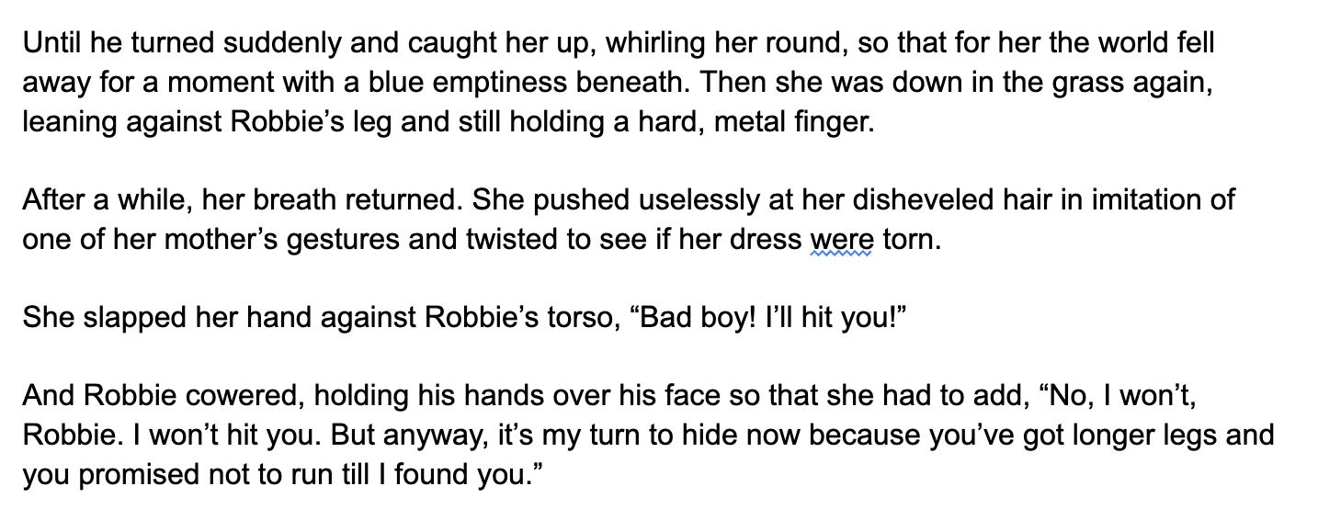
New words

Slide 55
Gloria says ‘Bad boy!’ to Robbie. What is she treating him like now?
How does Robbie react? What does this tell you about him?

Slide 56
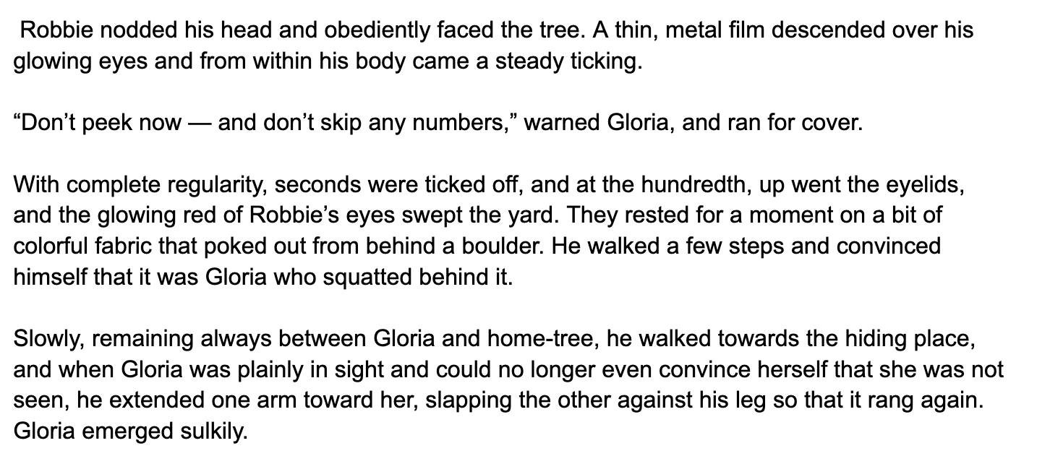
New words

Slide 57
How does the author’s description of Robbie remind us that he is a robot?

Slide 58
Point: The author’s descriptions makes it clear that Robbie is a robot.
Evidence:
Explanation:

Slide 59
What do you think the underlined word means?
Clue: think about the meaning of connected words, like ‘obey’

Slide 60
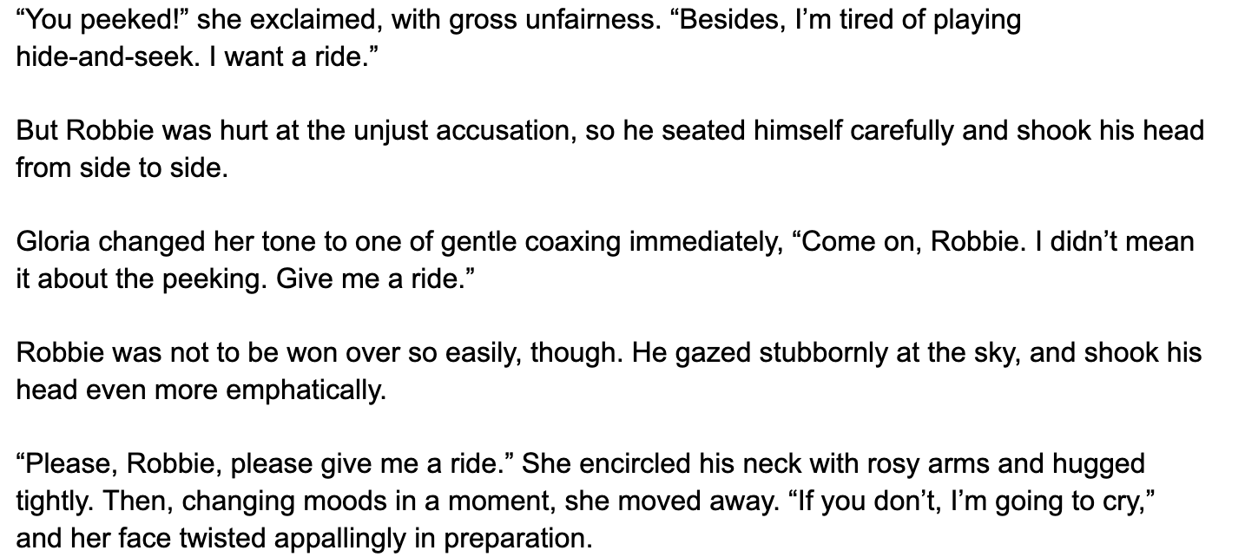
New words

Slide 61
Is Robbie’s reaction to being accused of peeking a surprise to you? If so, why?

Slide 62
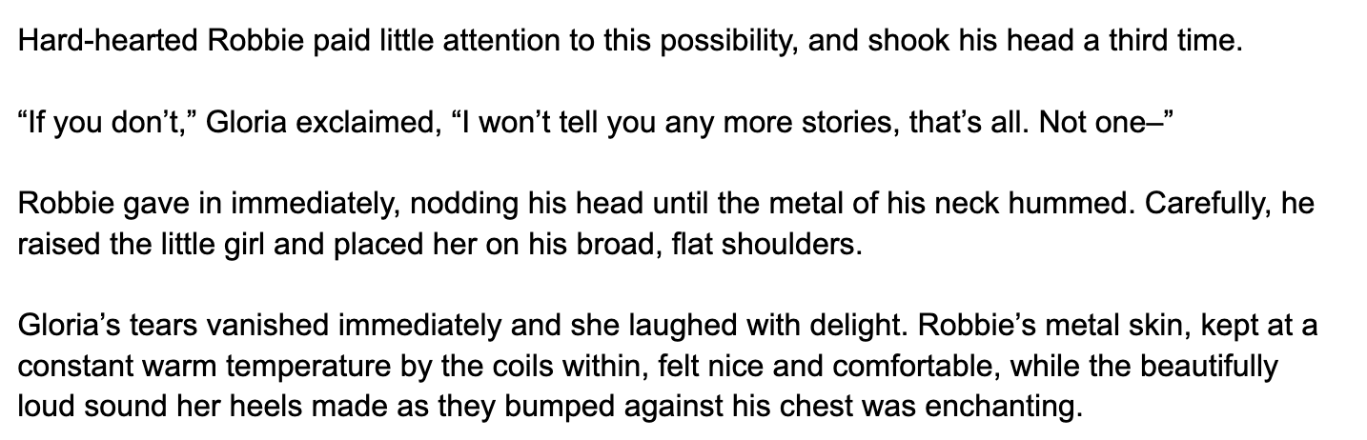
New words

Slide 63
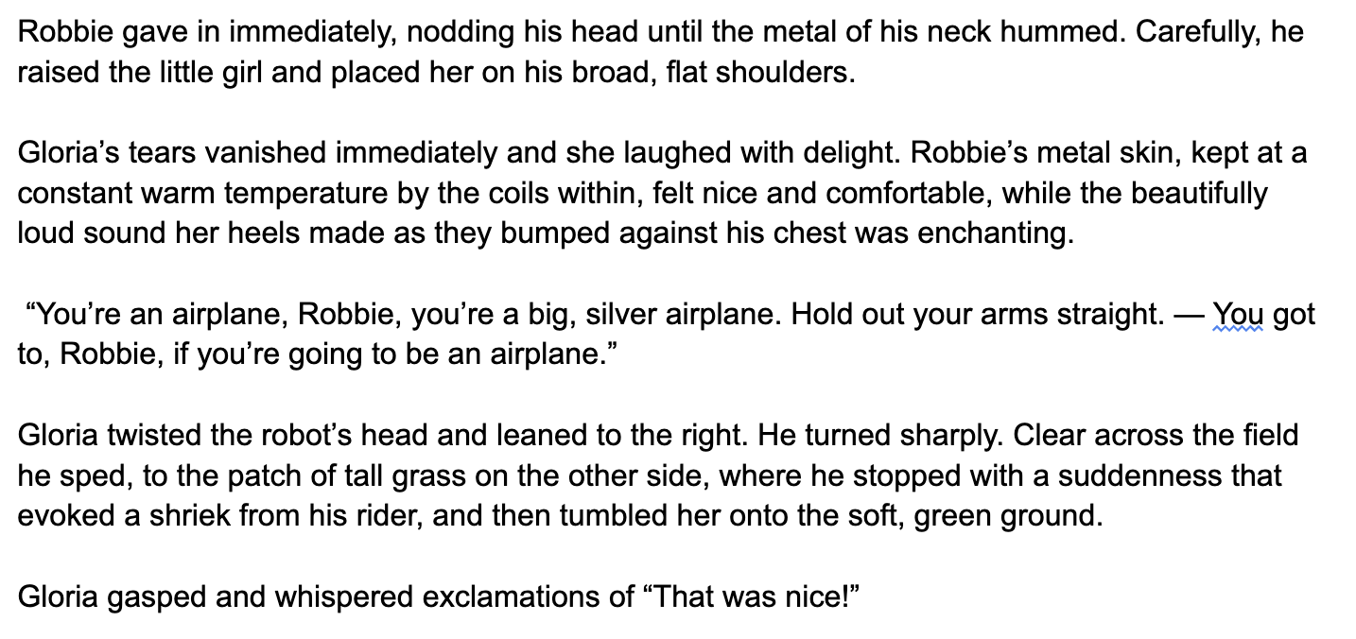
New words

Slide 64
How does the writer show that Robbie cares about Gloria’s safety? Give two examples.

Slide 65
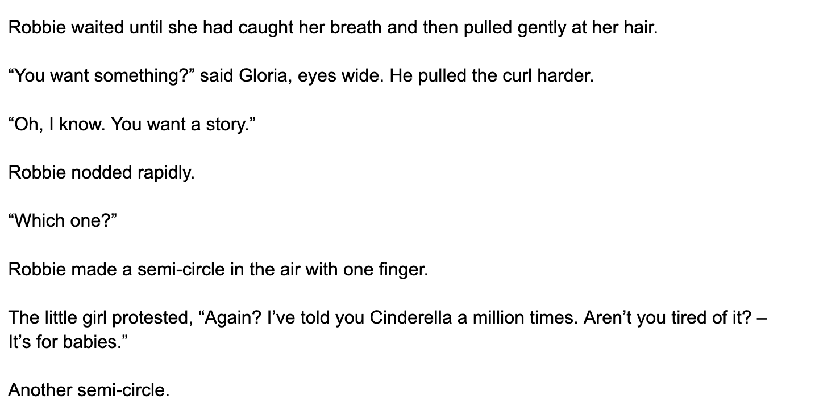
New words

Slide 66
Why doesn’t Robbie just tell Gloria what he wants? Why does he use gestures and actions?

Slide 67
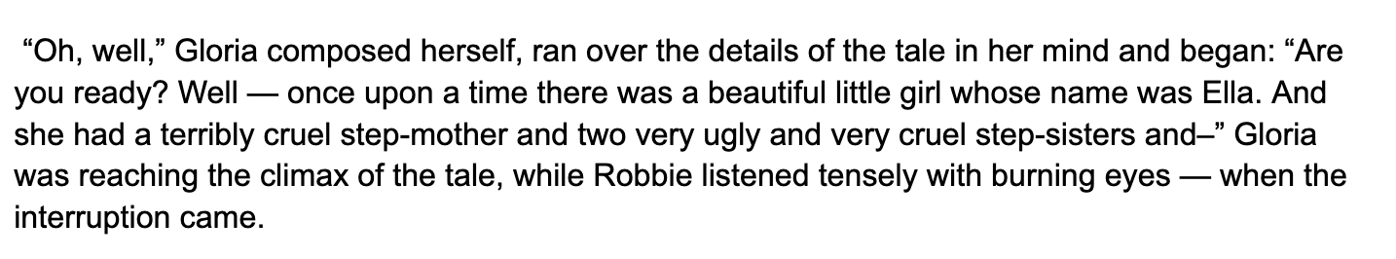
New words

Slide 68
Opinion:
Why do you think Robbie likes stories so much?

Slide 69
Can you remember your praise from yesterday?

Slide 70
Quiz questions!
What is the name of the girl in the story?
What game is the girl playing with Robbie?
Which form of transport does Robbie pretend to be?
Write two ways that the author shows Robbie is a robot.
Guess: Who interrupts the play between child and robot.

Slide 71
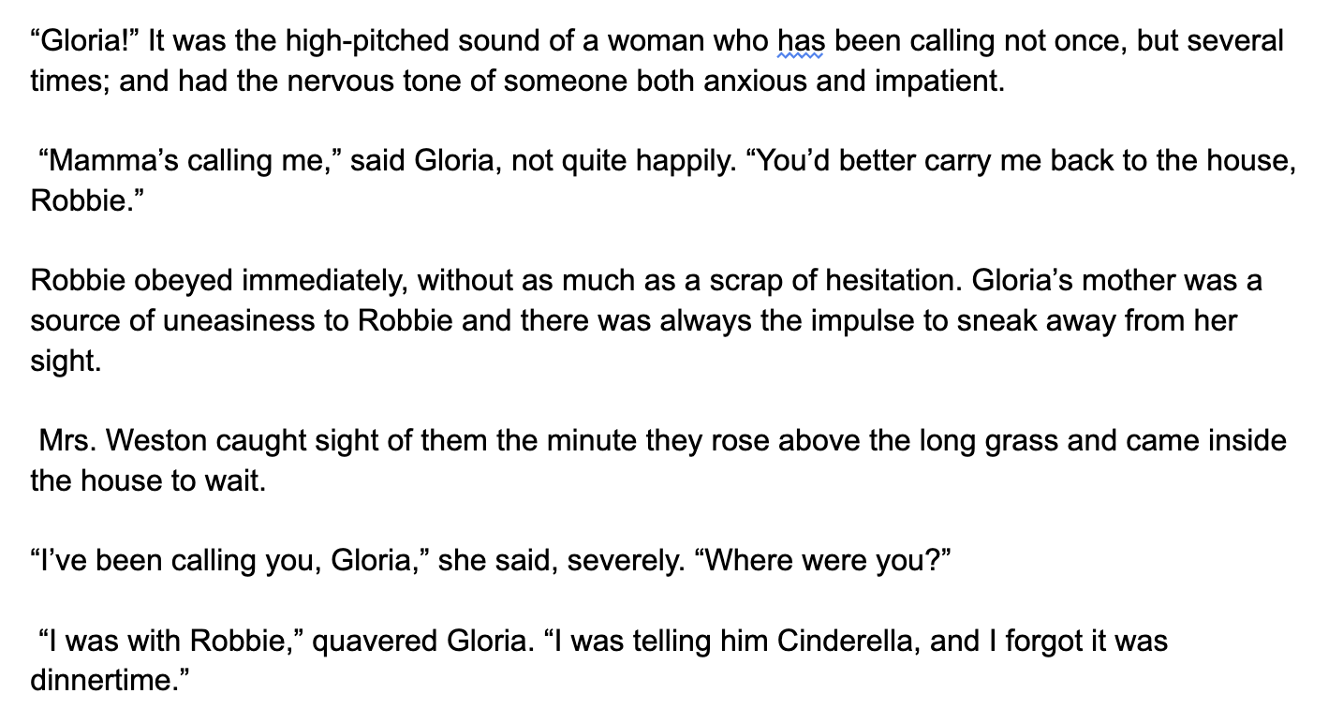
New words

Slide 72
Why do you think Robbie feels uneasy around Mrs Weston?

Slide 73

New words

Slide 74
What do we know about each character so far? Create a table with 4 columns and make notes.
Mr Weston | Mrs Weston | Gloria | Robbie
 |  | Doesn’t like losing! | Loves spending time with Gloria Mute; communicates using gestures
Likes playing with Robbie
Hide-and-seek
Robot
Metal body, red eyes
Robbie likes stories

Slide 75
Notice the way Gloria’s speech is described. Find these examples in the text so far…

Slide 76


Slide 77
Why doesn’t the author just use ‘said’?

Slide 78
You practise…
‘Wait!’
she exclaimed
she shrieked
she squealed
she warned
she shouted at the top of her voice
she gasped
she whispered

Slide 79
Look back at the descriptions of Robbie in the text. Draw Robbie.
Label the body parts you add to show understanding of the text.
If Robbie’s metal feet go ‘clumpclump’, what might they look like?

Slide 80
Recap…
Gloria and Robbie are having fun together. They play a game of _____________, then Robbie gives Gloria _____________. Gloria starts to tell Robbie _________________ but they are interrupted by _________________ who calls Gloria home for ______________. Gloria wants Robbie to stay so she can finish ___________________ but he is not allowed to. Robbie feels uneasy about ___________________.
Hide and seek
Ride on his back
Cinderella
Gloria’s mum
dinner
the story
Mrs Weston

Slide 81

Robbie’s inner voice
Dear Diary,
Today I had a wonderful afternoon with Gloria….
Write a diary entry by Robbie. You should:
describe what Robbie did with Gloria, and how he felt about it
describe how he felt about the interruption, and his feelings towards Mrs Weston.
describe what Robbie wants to do when he next sees Gloria.
Mrs Weston shouted at us angrily…

Slide 82

New words

Slide 83

New words

Slide 84

Imagine….
Robbie overhears Mrs Weston describe him as ‘that terrible machine’.
How does he feel?
What would he say?

Slide 85

Imagine….
Gloria overhears Mrs Weston describe him as ‘that terrible machine’.
How does she feel?
What would she say?

Slide 86

New words

Slide 87
‘It has no soul…’
Mrs Weston uses the pronoun ‘it’ to describe Robbie. What effect does this have?
She says that Robbie has no soul: no identity or consciousness.
Do you agree with Mrs Weston?

Slide 88
‘A child isn’t made to be guarded by a piece of metal’.
Mrs Weston doesn’t think that Robbie makes a good babysitter / nanny.
Describe what Robbie can do as Gloria’s babysitter and what he is not capable of.
E.g.
Robbie can understand what Gloria says.
Robbie isn’t able to talk.
How might his (lack of) capabilities affect how well he can babysit?

Slide 89

‘But now I don’t know… The neighbours -’
What do you think the neighbours are saying about Robbie?
That girl always seems to be with that robot of hers… Do you think it’s safe?

Slide 90

New words

Slide 91
Things that might go wrong…
Draw two different images showing what might go wrong if Robbie continues to spend time with Gloria. Caption each image.

Slide 92

New words

Slide 93
Quiz!
Who wrote the short story Robbie?
What is the other name for Gloria’s mum?
List two activities that Robbie and Gloria do together.
What’s Robbie’s favourite story?
How does Robbie feel about Gloria’s mum?
What does Gloria’s mum call Robbie?

Slide 94
If you were Mrs Weston, how would you take Robbie away from Gloria?

Slide 95

New words

Slide 96
True or False? Correct the false statements
Mrs Weston wants to keep Robbie.
Mr Weston paid a lot of money for Robbie.
The Weston family have had Robbie for four years.
Mrs Weston didn’t like Robbie at first.
Robbie is not popular with the neighbours.
Mr Weston believes Robbie is trustworthy.
Mrs Weston thinks being friends with a robot will harm her daughter.

Slide 97

Who do you agree with?
Mr Weston
Mrs Weston
We don’t need to get rid of Robbie. He is safe and Gloria loves him. Robbie cost a lot too!
We can’t trust Robbie. The neighbours don’t like him being around. Gloria needs to make real friends.

Slide 98
Free write
Would you take Robbie away from Gloria? Why or why not?

Slide 99

New words

Slide 100

New words

Slide 101
What has Mr Weston decided to do?
What influenced his decision?
How do you think Gloria will react?

Slide 102


You’re Mr Weston.
Think of a lie. Why can’t Robbie go to see the show with Gloria?
(Think of a lie that a young girl would understand/believe…)

Slide 103
Was your reason the same as Mr Weston’s?
Gloria wants to tell Robbie about the show. Why can’t she do that?

Slide 104

What did they buy Gloria? Why?

Slide 105


You’re Mrs Weston.
Think of a lie. Where has Robbie gone?
(Think of a lie that a young girl would understand/believe…)

Slide 106

Was your reason the same as Mrs Weston’s?
How is Gloria feeling about Robbie’s disappearance?

Slide 107


Slide 108
How do we know that Gloria doesn’t think of Robbie as a robot?

Slide 109
Point: Gloria doesn’t think of Robbie as a robot.
Evidence:
Explanation:

Slide 110

Gloria writes a ‘lost’ poster for Robbie
Lost ____________
Name: _____________
Age: ______________
Lost since: ________________
Last seen: ________________
Extra description: ______________________________
Reward(?): _________________________________

Slide 111


Slide 112
Questions
What did Gloria’s mum buy to replace Robbie?
Where has Robbie gone?
How does Gloria feel about this? How do you know?

Slide 113

What happened to the dog? Why?

Slide 114

What change of environment might help Gloria?

Slide 115


Of course she can’t forget Robbie here. How can she, when every tree or rock reminds her of him’.
I remember when Robbie and I…..
Draw a scene showing how Gloria’s environment reminds her of Robbie.

Slide 116
What are some physical signs of emotional stress?
Anger
Crying
Not smiling (smiling too much)

Slide 117


How do we know that Gloria is emotionally affected by the disappearance of Robbie?
Think of two reasons.

Slide 118


Slide 119

Why does Gloria think they are going to New York?

Slide 120

Perform Mr Weston’s reaction

Slide 121

It’s 1998! That’s over 25 years ago!
Did people have robot babysitters / nannies in 1998?
Think about what you know about the author, Isaac Asimov. Why did he choose for the story to take place in 1998?

Slide 122


Slide 123


Slide 124


Slide 125


Slide 126
The story so far…
Summarise the story to a partner. What was the last thing that happened?

Slide 127

Why do you think it was too much for the robot to know that other robots exist?

Slide 128
Keywords
To be ‘sentient’ means to be able to experience feelings and sensations.
To be ‘self-aware’ means to have consciousness - to know that you exist.
HOW DO YOU KNOW THAT YOU EXIST?

Slide 129


Slide 130

Are you surprised by how much Gloria wants to find Robbie? Why / Why not?

Slide 131


Slide 132


How would you try to convince Gloria that Robbie is just a robot?

Slide 133


Slide 134
How do you think the story will end?
Free writing 10 minutes.

Slide 135


Slide 136

Gloria thinks she’s seen Robbie!
What will she do? What will happen?

Slide 137


FREEZE FRAME!

Slide 138

Freeze frame
Gloria has broken through the railings and is on the factory floor. Mr Weston tries to stop her.
She is running to see Robbie
There is a vehicle on the factory floor that is not manned. It is moving in Gloria’s direction.
Mrs Weston looks at what is happening.
YOU HAVE 4 MINUTES TO CREATE YOUR FREEZE FRAME

Slide 139


Slide 140

Imagine! You were a witness to the incident!
Describe what you saw happen.
Remember to use past tenses correctly…
I was working on the factor floor. I saw a girl…
Were you a human or a robot?

Slide 141


Slide 142
Imagine you are Mrs Weston
What would you do?
Robbie has just saved your daughter’s life, but you don’t want this ‘terrible machine’ around. Your husband has found a way for Gloria to meet Robbie again - he has betrayed you.
If I were Mrs Weston, I would…

Slide 143


Slide 144
Questions
What did you think of the story?
Did you agree with the ending? Were you surprised by it?
What alternative ending would you suggest?
Would you like a friend like Robbie? Why / Why not?

Slide 145
Summarise…
Summarise the story in around 100 words.
Robbie by Isaac Asimov is a story about…
The main themes of the story are…
In this story, [describe the storyline]

Slide 146
In the story "Robbie" by Isaac Asimov, a little girl named Gloria has a robot named Robbie who is her best friend. Robbie takes care of her, plays with her, and protects her. Gloria's mother worries that Robbie is not safe for her daughter, believing robots shouldn't be trusted. She insists on getting rid of Robbie. When Robbie is sent away, Gloria is heartbroken. Eventually, a crisis occurs, and Robbie saves Gloria from danger, proving he is loyal and protective. In the end, her mother realizes that Robbie is a good friend and allows him to stay.

Slide 147
Your opinions on the story.
Things I liked (and why) | Things I didn’t like (and why)
Robbie
The ending
The visit to the factory
Mrs Weston
Gloria
The storyline
The hide-and-seek scene

Slide 148
Add a paragraph on likes and dislikes to your summary to make a review.
I really liked the ___________________________________________.
However, I think some aspects of the story could improve. For example, _____________.
Overall, I think Robbie is [an interesting story / a sad story / etc].
Star rating:

Slide 149
I love how "Robbie" explores the theme of friendship between humans and robots, showing that true companionship can transcend boundaries. The story also highlights the protective nature of Robbie, illustrating his loyalty and ability to care for Gloria. However, one area for improvement could be character development; Gloria's mother feels a bit one-dimensional as an antagonist. A deeper exploration of her fears and motivations could add more complexity to the story and enhance the emotional impact.

Slide 150
Overall…
Overall, I really enjoy "Robbie" for its heartfelt exploration of friendship between humans and robots, showcasing loyalty and protection. The story raises thought-provoking questions about trust and companionship in a changing world.

Slide 151
Your common assessment…
Tasks we have completed in class:
Free writing tasks
Diamond 9 speaking
PEE paragraphs
Character descriptions
Drawing Robbie
Robbie’s diary entry
Robbie and Gloria’s responses to Mrs Weston’s opinions
Mr and Mrs Weston’s excuses/lies
Lost poster
Gloria’s memories of Robbie in her environment
Freeze frame
Witness report of Gloria in the factory
Your summary

