Slide 1
Building vocabulary (bit by bit!)
Secondary EAL department

Slide 2
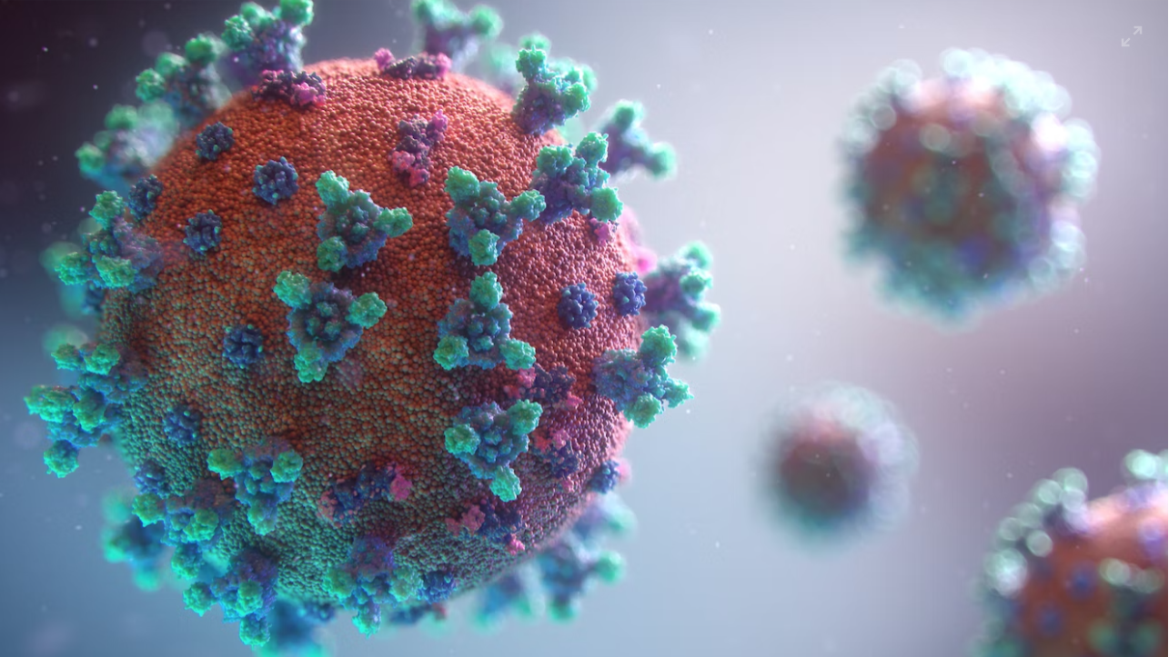
What theme or topic connects these words?
anti-vax
anti-vaxxer
precaution
self-isolate
rename
unprecedented

Slide 3
What is similar about how these words are formed?
anti-vax
anti-vaxxer
precaution
self-isolate
unprecedented
rename

Slide 4
What is similar about how these words are formed?
anti-vax
anti-vaxxer
precaution
self-isolate
unprecedented
rename

Slide 5
What’s a prefix?
A group of letters placed before a word
It changes the meaning of the ‘root’ word
Un + happy = unhappy

Slide 6
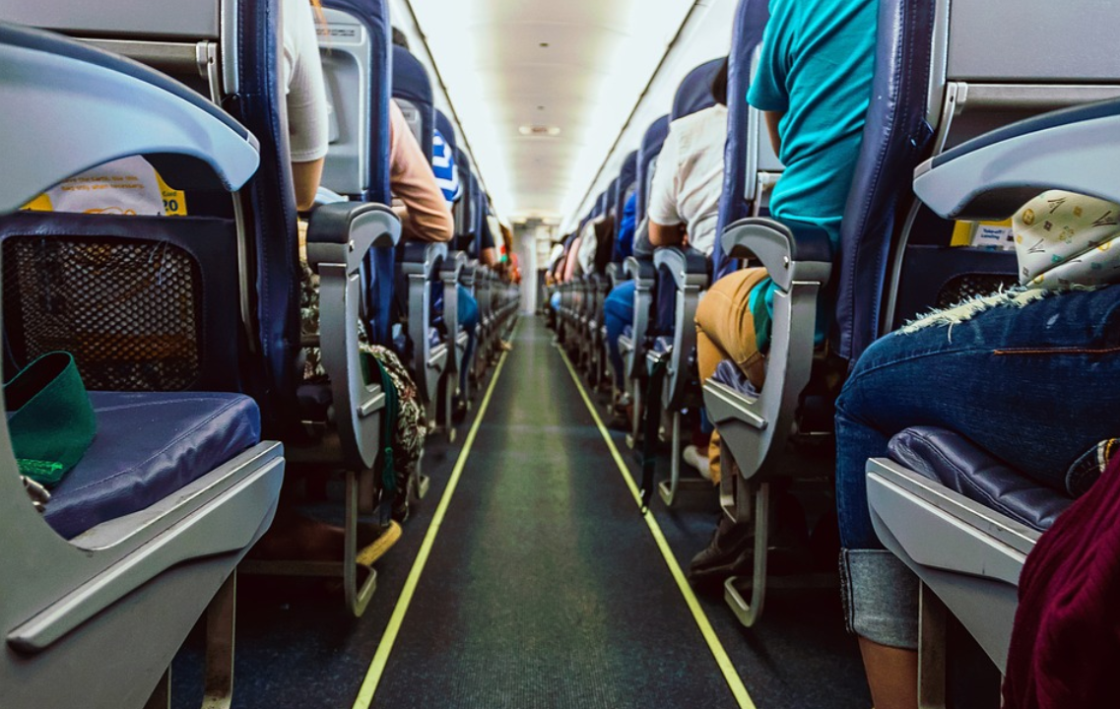

Prefixes have meanings!
Un -
uncomfortable
not

Slide 7
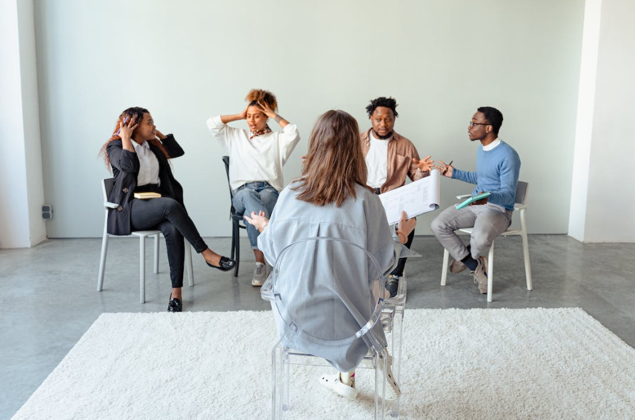
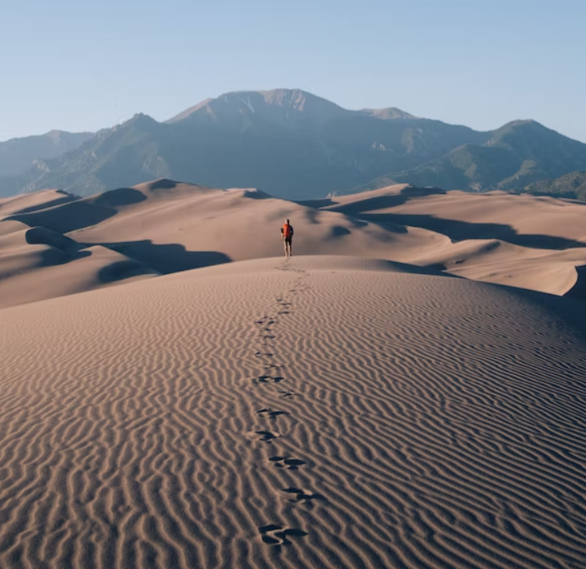
Prefixes have meanings!
Dis -
De -
disagree
opposite, not
dehydrated
opposite

Slide 8
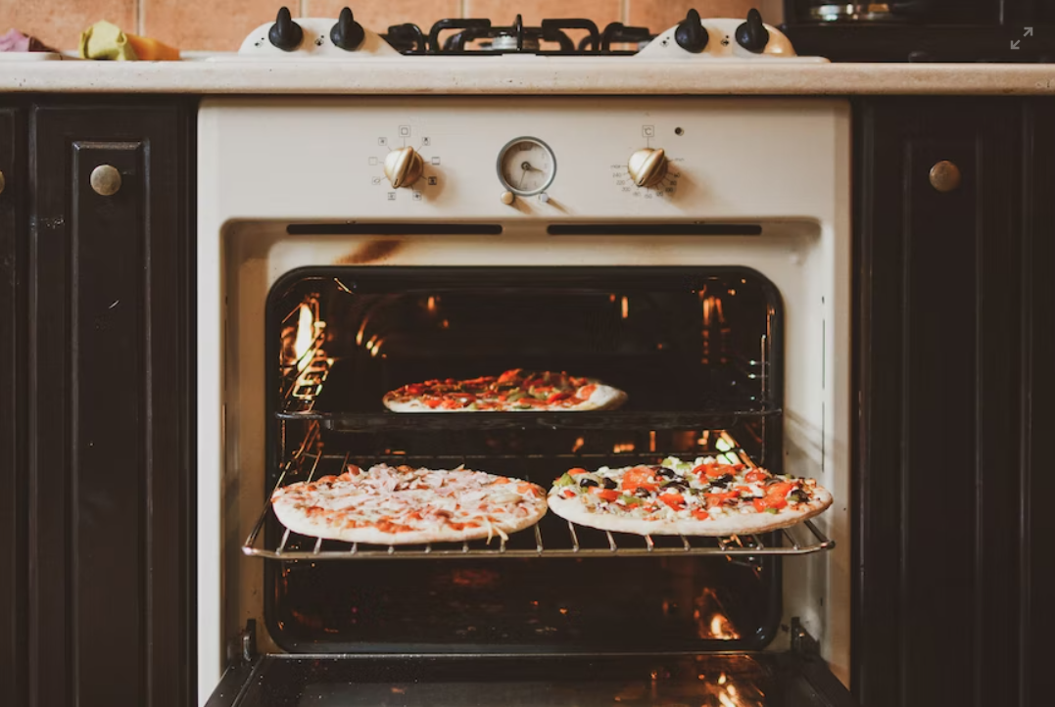
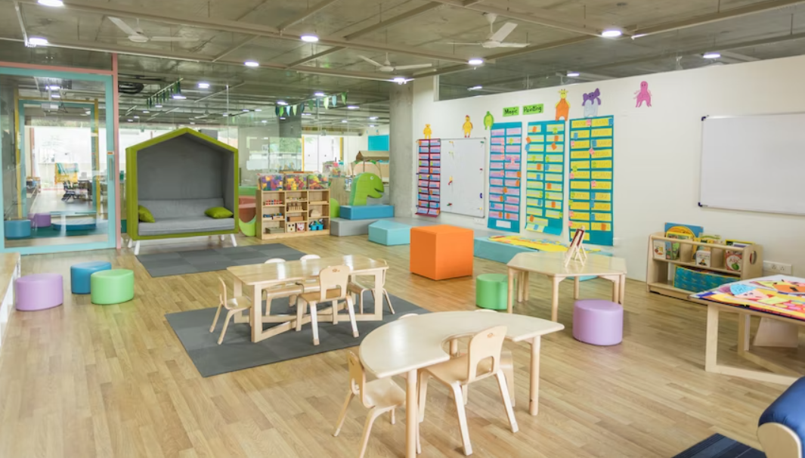
Prefixes have meanings!
Pre -
preheat
before / earlier
preschool

Slide 9

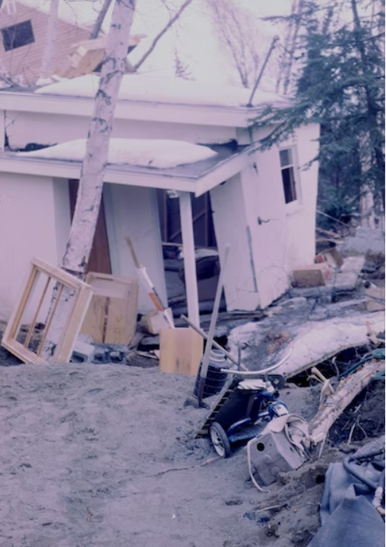
Prefixes have meanings!
Re -
rewrite
again
rebuild

Slide 10
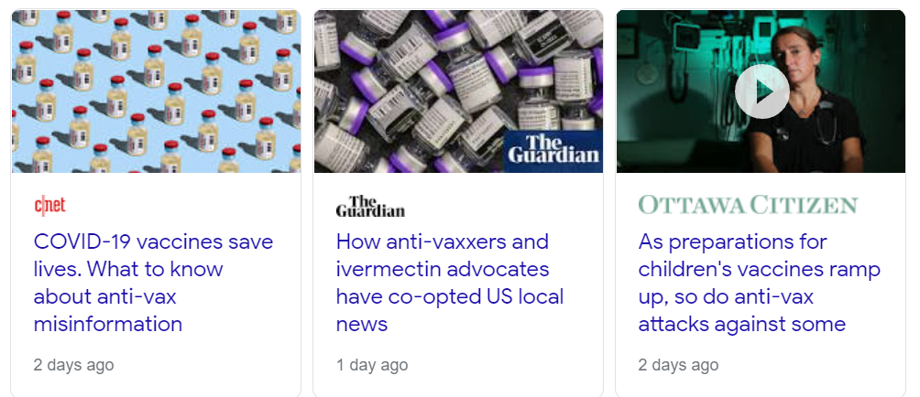
Prefixes have meanings!
against / opposed to
Anti -

Slide 11
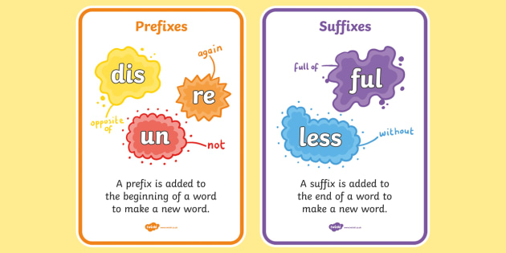
But we know this, Mr Pete!

Slide 12
If you study/speak a Latin-based language OR Greek...
Meaning | Latin prefix | Greek prefix
against | contra- (in- , ob-) | anti-
across, through | trans- | dia-
again | re-

Slide 13

But do others know it, and can it help them?
Learners at St. Andrews have a wide range of first languages.
We have some learners who have been studying in English for a short time only.
We need to support each other and help each other develop our language skills and knowledge.
Remember, we are a community of care.

Slide 14
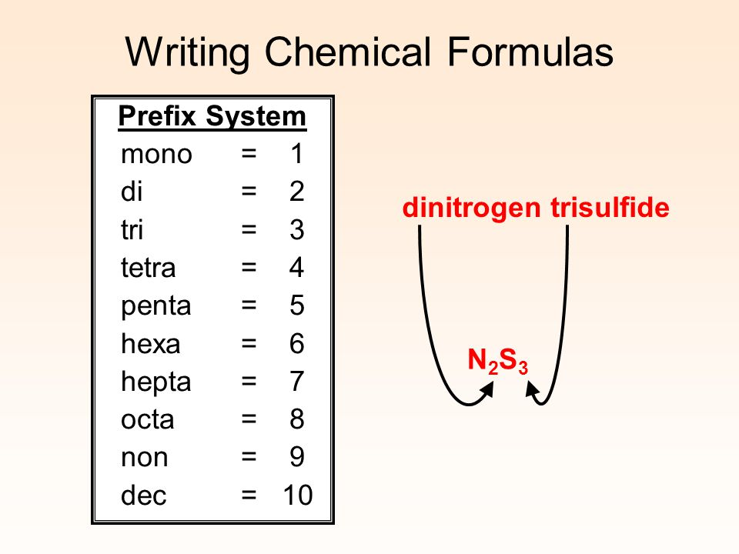
How can knowing about prefixes REALLY help me?
Learning other languages!
되 = re-
Noticing language patterns in certain subjects
© Beverley Malone

Slide 15
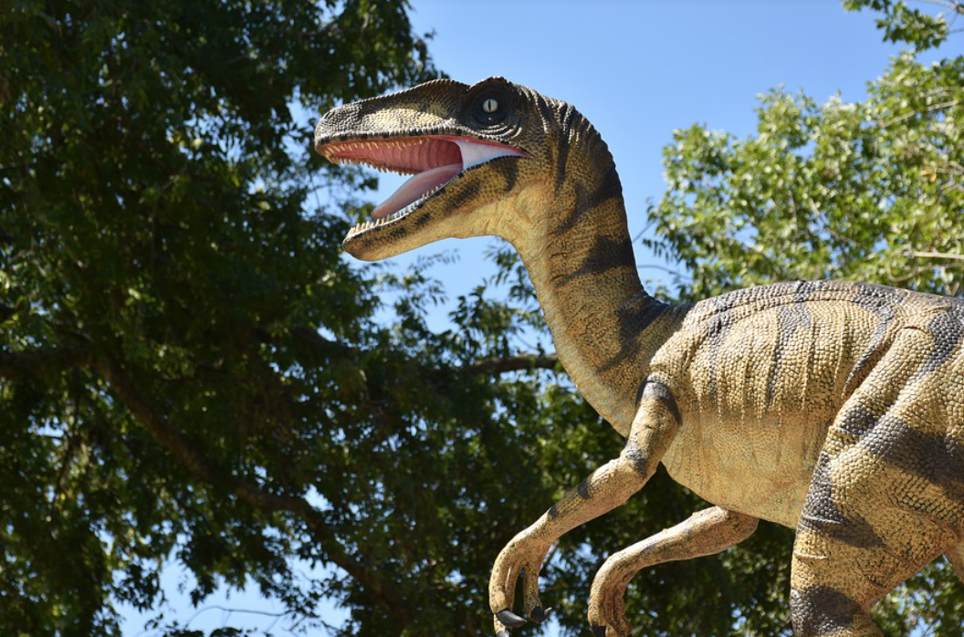
Prefixes in our subjects: History
Prehistoric
Pre-date
Pre-industrial era

Slide 16
Prefixes in our subjects - Business
Miss Steph:
‘So when you have a job you are ‘employed’. What about if you don’t have a job because you can’t find work. You are…?’
unemployed

Slide 17
Have you learnt a word this term that begins with…?
In which subject did you learn it?
Anti-
Trans-
Re-
Pre-
Un-
Mono-
De-
Dis-
Post-
Co-
Pro-

Slide 18

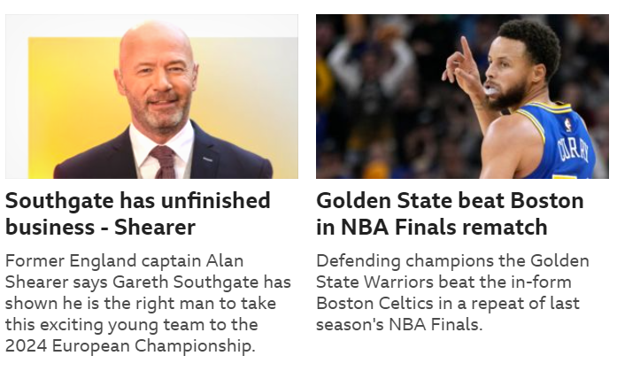
Take-home points
Look for patterns in language
Help each other notice patterns
Prefixes are all around us

Slide 19
Image attributions
Coronavirus: Photo by Fusion Medical Animation on Unsplash
Unable to load video: iPhone notification
Airline seat: Image by Jojo Suan from Pixabay
People disagreeing: Photo by Antoni Shkraba: https://www.pexels.com/photo/people-in-a-psychotherapy-session-7579174/
Pre-school: Photo by Gautam Arora on Unsplash
Oven: Photo by Stefan C. Asafti on Unsplash
Damaged building: Photo by NOAA on Unsplash
Proof paper: Image by Lorenzo Cafaro from Pixabay
Screenshot of news from Google
Screenshot of prefix/suffix resources from Twinkl.com
Languages vector: created by Berkah Icon at Noun Project
Writing chemical formulas slide borrowed from Beverley Malone at slideplayer
Dinosaur: Image by Ray Shrewsberry • 💙 💙💙 from Pixabay
Coronavirus graphics from Pennsylvania Dept of Health https://www.health.pa.gov/topics/disease/coronavirus/Pages/Social-Media.aspx
Ronaldo headline from AP Press (here 12/12/2022)
BBC Sports headlines (here 12/12/2002)

