Slide 1
Hidden words...

Slide 2
Rules
There are 6 hidden words in each picture. Find them.
To get a point you need to explain where you can see them in the picture.
You get 1 point for finding the word, ½ a point for saying the word correctly, and ½ a point for explaining the meaning of the word/using the word in a sentence.
Pictures from https://www.boredpanda.com/find-words-challenge/

Slide 3
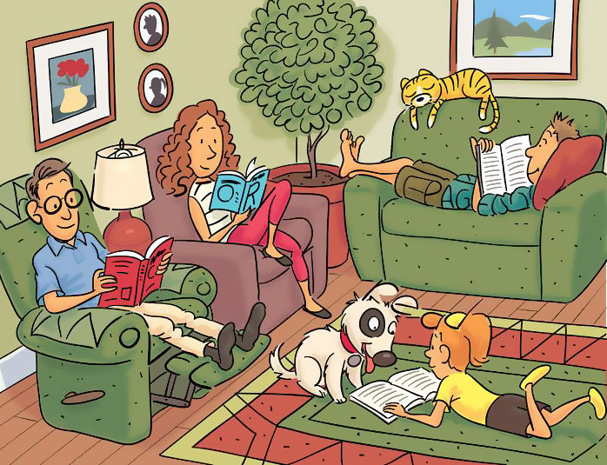

Slide 4
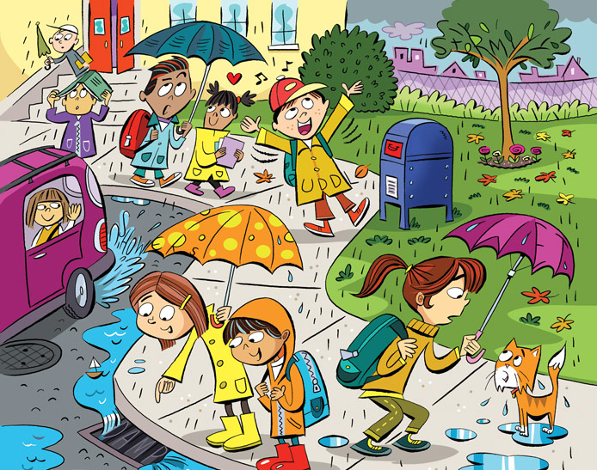

Slide 5
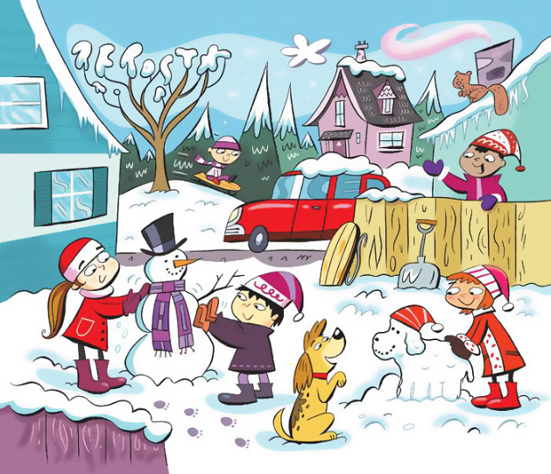

Slide 6
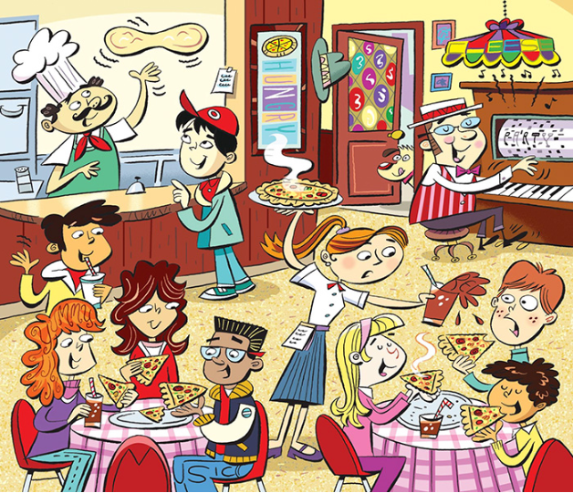

Slide 7
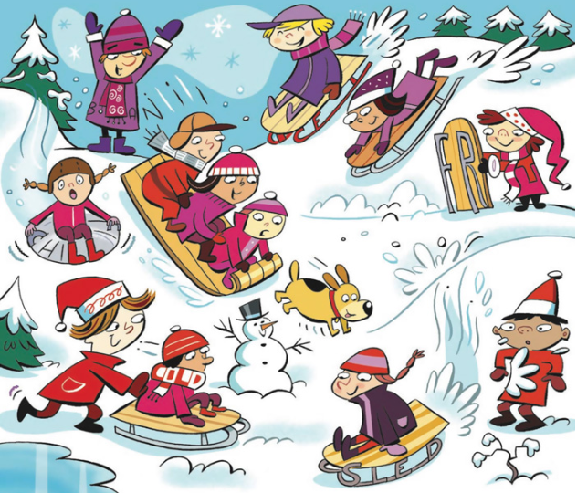

Slide 8
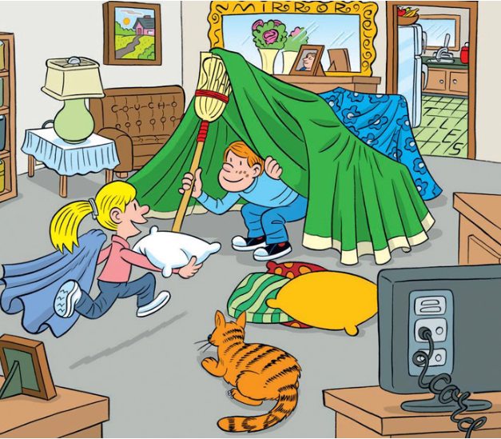

Slide 9
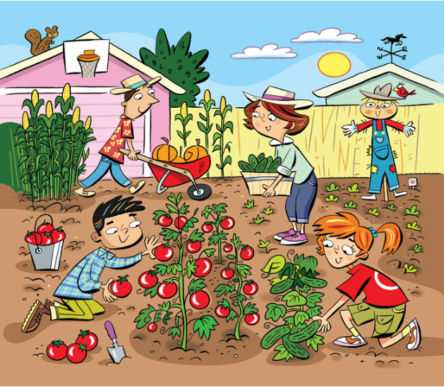

Slide 10


Slide 11
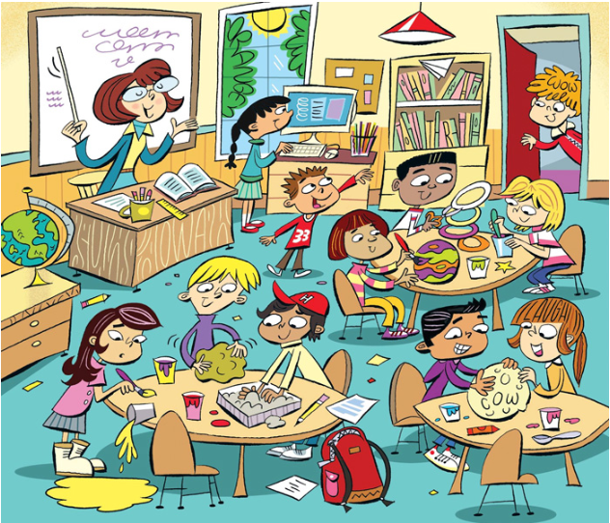

Slide 12
